Slide 1
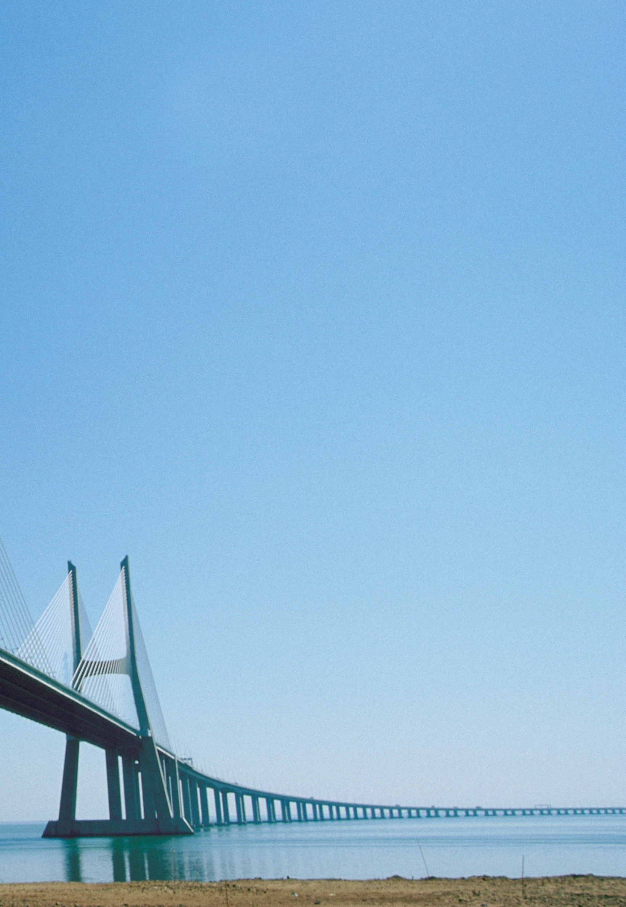

Portugal
Business opportunities
Country profile
Reliance Restricted
10 March 2017

Slide 2

In this report
 | Page
Highlights | 4
Overview of Portugal's economy | 6
Geographic and demographic analysis | 7
Macroeconomic profile | 9
Market trends and growth prospects | 13
Energy and Renewables | 16
Market specifics, figures and key trends | 17
Historic evolution and forecasted growth | 18
Value chain and main players | 20
Imports, exports and trade balance | 21
Key players | 22
M&A activity in Portugal | 23
What can India gain? | 24
Agriculture and Agro-foods | 25
Market specifics, overview, size and value | 26
Exports, imports and trade balance | 27
Key success factors | 28
Key players | 30
M&A activity in Portugal | 31
What can India gain? | 32
Defense | 33
Industry and main KPI’s | 34
Innovation and technology | 35
Key players | 37
What can India gain? | 38
Tourism and Hospitality | 39
Market specifics, indicators and impacts | 40
Market segments and main KPI’s | 41
Key success factors | 42
Key players | 44
M&A activity in Portugal | 47
What can India gain? | 48

Slide 3
In this report
 | Page
Infrastructure and Construction | 49
Market specifics, size and value | 50
Roads and ports concession model | 51
Expectations for the future | 52
Key players | 53
M&A activity in Portugal | 54
What can India gain? | 55
Water and Waste management | 56
Water, waste and distribution | 57
Solid waste management and recycling | 58
SWM market value, trade balance and strategic guidelines | 60
Key players | 61
M&A activity in Portugal | 62
What can India gain? | 63
Investor’s guide and Business development | 64
India-Portugal relations | 65
Opportunities and threats in Portugal | 66
Testimonials | 67
Financial incentives schemes | 69
Tax incentives schemes | 71
Appendices | 73
Abbreviations | 73
Relevant contacts | 74

Slide 4
Highlights
Portugal: snapshot
Macroeconomic data
Attractiveness
12.4%
Unemployment
rate 2015
10.3m
Population
#15
Infrastructure
index
260m
Portuguese
speakers
€179bn
GDP in
2015
508m
People
accessible
65.6%
GDP in private
consumption
60%
Speak foreign
languages
0.83
Human
Development
Index
46 | 39 | 5
Global Competitiveness Index - World Economic Forum 2016-2017 138 countries | World Competitiveness Scoreboard – IMD 2016 61 countries | Global Peace Index - Vision of Humanity 2016 162 countries
64 | 19 | 31
Index of Economic Freedom - The Heritage Foundation 2016 178 countries | Best Countries for Business – Forbes 2016 139 countries | Bloomberg Innovation Index 2017 50 countries
Forecasts and trends
Sectors overview (% of GDP)
1.5%
Average GDP growth until 2018
18%
Industry weight on GDP by 2020
€ 600
Minimum wage foressen by 2019
11%
Unemployment forecast for 2017
6.6%
External debt CAGR until 2020
17.2%
Investment in % of GDP in 2021
Portugal 2020
Portugal is on track to reach objectives
The sectors presented in the following pages of this report are considered of common interest between India and Portugal. Each sector presents an in-depth analysis of the Portuguese reality, recent trends, main players and recent M&A activity. Moreover, gaps and opportunities have been identified so that Indian potential investors could benefit of and cooperation between the two countries can be further fostered.

Slide 5
Highlights
Why invest in Portugal
Top 6 reasons to invest in Portugal
Strategic location |  | Qualified workforce
Provides access to larger markets of the EU (508m people) and Portuguese speaking countries (260m). Located on the southwest European Atlantic coastline with strategic connections with America, Central Europe and Africa. |  | 26% of graduates are from sciences, engineering, and technology (above euro average); 60% of population speaks at least one foreign language and 5% of population are foreigners; 2 management schools in the Financial Times Top 30 of best in Europe.
World class infrastructure and technological services |  | Favorable business environment
Portugal ranks #15 in overall quality of infrastructure and #24 in air transport infrastructure; 99.8% of households have fixed broadband coverage; Ranks #37 in e-government development index. Portugal is a leading country in performing operations through ATM network. |  | World Bank’s “Doing Business 2017” report ranks Portugal at #25 in ease of doing business and #19 in enforcing contracts, out of a total of 190 countries.
Competitive costs |  | Peaceful country and good quality of life
Ranked #69 (out of 120 countries) in terms of labor costs per hour. Cost of living in Lisbon is €13.2/hour. Lisbon is the least expensive city out of 37 European cities for office space. |  | Portugal ranks #6 (out of 163 countries) in the Global Peace Index. The World Economic Forum, in 2016, ranked Portugal as #9 (out of 140 countries) with the smallest impact of crime and violence in business activities. Earned several awards promoting quality of life in Portugal (ex. World’s Leading Golf Destination 2013, Europe’s Leading Beach Destination 2016, Lisboa Golf Coast – Golf Destination of the Year 2016).
Strategic sectors focus
Considering that India and Portugal share similar priorities in terms of boosting domestic economic growth, investment, employment, industry and innovation, there are several sectors where partnerships can be forged to mutual benefit, such as: renewable energy, agro-processing, tourism & hospitality, infrastructures (roads, ports) and water & waste management. More details in relation to all these strategic sectors are presented on the following pages.

Slide 6

Portuguese economy overview
1
Key Indicators
75%
Percentage of Services on GVA
#15
Best infrastructures in the world
260m
Portuguese-speakers in the world
€90m
Total Indian investment in Portugal (based on disclosed amounts) 24
Number of Indian citizens, as of 2015, under the Portuguese Golden Visa program
Source: INE
Source: World Economic Forum
Source: CPLP and Eurostat
Source: Embassy of India in Portugal
Source: Portuguese immigration and borders services

Slide 7
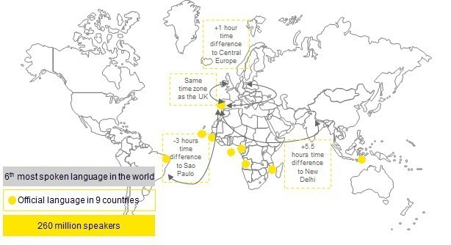
Geographic and demographic analysis
Portugal in the world
International positioning
  Located on the Atlantic side of the Iberian Peninsula, next to Spain, and with 943km of coastline, Portugal is strategically positioned between Europe, Africa and America.
  In terms of population density, coastal areas and, in particular, cities are highly populated. The main cities are Lisbon and Porto.
Portuguese language
The Portuguese language is spoken by 260 million people. It is the official language in Portugal, Angola, Brazil, Cape Verde, East Timor, Guinea-Bissau, Mozambique and São Tomé e Príncipe.
It is also spoken in locations like Andorra (11,700 speakers), Macau (4,020 speakers), France (959,000 speakers) and India (250,000 speakers mainly in Goa, Daman and Diu, Dadra and Nagar Haveli).
The strong economic relations and cultural ties between Portuguese-speaking countries reinforce the importance of Portugal as a point of entrance to the Portuguese-speaking geographies and markets.
10.3m
Population
112.6
Inhabit./ sq km

Slide 8
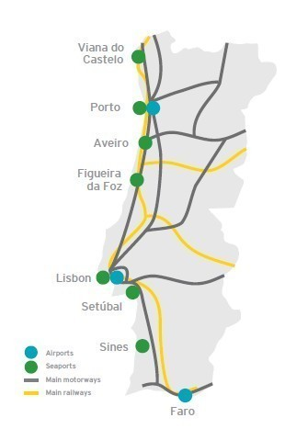
Geographic and demographic analysis
Portugal infrastructure network
International accessibility
  Portugal has a central location, is easily reachable by road from European countries (Spain, France or Germany) and has flight connections to cities like Madrid or Rabat in one hour.
  Infrastructure
  Road – Effective access to the EU countries through Spain due to high quality of roads. Portugal ranks #4 (among 28 EU countries) in the ‘Quality of roads’ category of the ‘Portugal Investment and Infrastructure – European Commission’ in 2015-2016.
  Rail – Portugal has 2,544km of rail lines which provides access between North and South locations and also to Spain.
  Air – Includes 15 airports, out of which 3 are international airports (Lisbon, Porto and Faro) with daily flights to and from European cities and African and Brazilian destinations. There are more than 1100 direct flights per week to more than 100 destinations.
  Maritime – ports of Sines, Setúbal, Lisboa, Aveiro, Figueira da Foz, Leixões and Viana do Castelo provide connections to the main maritime routes. Considered the 25th best in the world by Word Economic Forum.
From Lisbon | By air (hours) | By road (hours)
Madrid | 1 | 5.5
Paris | 2 | 16.7
Munich | 3 | 23.5
London | 2.5 | 20
Rabat | 1 | n.a.
Source: travelmath.com

Slide 9
Macroeconomic profile
Business environment
Political background
  Portugal has a parliamentary democracy.
  The head of State is the President of the Republic, which is elected for a maximum of 2 terms of 5 years each by direct universal suffrage. The current President of the Republic is Marcelo Rebelo de Sousa.
  The Government, which conducts the country’s general policy, is currently headed by the Prime Minister António Costa.
  The legislative power is represented by the Assembly of the Republic (national parliament), which is constituted by 230 deputies.
        Doing business
  The World Bank Index ‘Doing business’ ranks Portugal at #25 out of 190 economies in assessing ease of doing business.
  When comparing business environments, the ‘Doing business’ rank defines the following characteristics for Portugal:
  Trading across borders - easier due to the implementation of an electronic single window for port procedures, which reduced the time and cost of trading.
  Resolving insolvency - takes on average only 2 years and costs 9.0% of debtors estate.
  Enforcing contracts - takes 547 days and represents a cost of 13.8% of claimed amounts.
  Registering property - easier since the establishment of a one-stop shop for property registration in 2011.
  Starting a business - takes on average 4.5 days and 5 procedures. The business reforms implemented resulted in an increasing number of start-ups in the country.
  Paying taxes - easier due to the implementation of a tax online filling system and due to the decrease of the CIT rate.
  Access to electricity - improved due to a reduction in the time required to receive electrical connection approval.
Competitiveness
  Portugal ranks #46 out of 138 economies, according to ‘The Global Competitiveness Index 2016-2017’ (World Economic Forum).
  Characterized as an Innovation-driven economy, Portugal’s highly scored pillars include the categories of ‘Health and Primary education’, ‘Infrastructures’ (namely the quality of the roads) and ‘Technological readiness’ (with emphasis on the quality of internet bandwidth).
  However, some potential for improvement is identified by the World Economic Forum in the categories of ‘Tax rates’, ‘Government bureaucracy’ and ‘Political stability’.
Trading across borders (#1 out of 190)
1
17
18
19
20
PT
EST
SWE
LIT
SAN. MAR
Resolving insolvency (#7 out of 190)
7
8
9
10
11
PT
DEN
PUER
BEL
NET
1
Enforcing contracts (#19 out of 190)
19
20
21
22
23
7
PT
USA
HK
SWE
LAT
Registering property (#27 out of 190)
19
27
28
29
30
31
27
PT
HUN
NET
AUS
CZE
Starting a business (#32 out of 190)
32
32
33
34
35
36
PT
ICE
S.TOM
MONG
LIBE
Paying taxes (#38 out of 190)
38
38
39
40
41
42
PT
SOL
AZE
MOR
AUS
Access to electricity (#50 out of 190)
50
50
51
52
53
54
PT
IT
GRE
SLOV
BHU

Slide 10
Macroeconomic profile
Evolution of Portuguese economy (I)
        Current economic outlook
  Earlier in this decade, Portugal faced a financial crisis. In April 2011, it received a financial bailout from the IMF and European Union. Several structural reforms were implemented in order to meet the objectives defined by the assistance program.
  After 3 years, in May 2014, the financial assistance program ended and Portugal gained access to International Debt Markets and has begun to repay its IMF loans ahead of schedule.
  Since then, the Portuguese economy has been slowly recovering, with a positive growth in GDP, a decrease in unemployment rate, a reduction in the government budget deficit and increasing domestic demand.
  Oxford economics latest report on Portugal forecasted that the Portuguese economy “might have gained some momentum in Q4 of 2016”, mainly based on the recent improvement of industrial and consumer confidence indicators. However, some risks were also identified, with banking stress and the rating downgrade being the main emerging risks mentioned.
  According to Business Monitor International, GDP is expected to show higher real growth in 2016 at 1.7%, then 1.6% in 2017, and 1.4 % in 2018, before stabilizing at a 1.1% growth rate towards the end of the decade.
Split of GDP by sector
  Portugal is a service-based economy with services and tourism having a material impact on the country’s GDP.
Public deficit
  According to the Office for Economic Policy and International Affairs (GPEARI), in the first semester of 2016, the government deficit continued its downward trajectory, representing 2.8% of GDP.
  The decrease results from (i) a decrease of capital expenditure and subsidies and (ii) the increase in taxes on production and imports.
Source: INE
Source: INE, Business Monitor Internacional
Source: INE

Slide 11
Macroeconomic profile
Evolution of Portuguese economy (II)
Unemployment
Unemployment rate has been decreasing since 2013 (16.2%) and reached 12.4% in 2015.
Currently, Portuguese unemployment can be seen as an opportunity for employers and investors:
32% of active population aged less than 25 years old is unemployed;
9% of active population with a university degree is unemployed.
Price evolution
  The HICP has been increasing since 2014 (when it registered a low of -0.3%). In 2015, the inflation was 0.5%.
Labor market
  94.5% adult literacy rate
  62.7% of urban population
  64.6% of population are internet users
  Human Development Index of 0.83
  Ranks #2 (out of 38 countries) in the Migrant Integration Policy Index reflecting the easiness of integration of foreigners
    ~8.2 average years of schooling
    48% population with at least some secondary education
    5.3% of public expenditure on education (% of GDP)
    ~81,000 Portuguese students completing a degree per year
    2 Top Portuguese management schools in the Financial Times’ Top 30 of the best in Europe
    26.6% of the population (aged 25-24) that speaks at least one foreign language (20.5% speak two foreign languages)
    32% of the 2014 class of bachelors have graduated in social sciences, business and law
€650 monthly salary - Portugal ranks #16 among other EU countries. Due to the high level of unemployment (12.4% in 2015), the pressure on wages is limited and salaries are expected to remain relatively stable.
12.4%
2015
Source: INE
Source: INE
Source: Eurostat (2014)

Slide 12
Macroeconomic profile
Tax framework
Taxes and contributions
The regulatory and tax environment bears substantial weight for investors. Within this context, incentives can be useful to attract investors.
However, Portugal is not usually considered best in class in this matter. Portugal’s ranking are as follows: (Doing Business):
  4 (out of 5) legal and overall level of maturity
83.8 (in 100) payment of taxes
29 (out of 139) level of bureaucracy
36 (out of 139) tax burden
Key areas for improvement relate to:
stability and/or predictibility associated with tax laws;
definition of incentives to promote investment in specific areas (and that would cover also services);
Simplification of processes related to existing grants
Key Tax rates
Corporate Income Tax (IRC)
Normal rate | 21%, 16,8% (Azores)
Reduced rate (SMEs) | 17%, 13,6% (Azores)
Value Added Taxes (VAT - Mainland
Normal rate | 23%
Intermediate rate | 13%
Reduced rate | 6%
Property municipal taxes (IMI)
Urban | Variable: de 0,3% a 0,45%
Rural | 0,8%

Slide 13
Market trends and growth prospects
Government agenda and strategic sectors
Government support
  Foreign investment is welcomed by the Portuguese Government and there is no discrimination between local and foreign investors.
  AICEP Portugal Global is the public agency responsible for providing support for FDI in Portugal. The entity represents the government support in monitoring negotiations and the internationalization processes of foreign companies to Portugal.
        Financial incentives - Portugal 2020
        Portugal 2020 is a partnership agreement between Portugal and the European Commission that includes 5 European Structural and Investment funds to be applied in the Portuguese economical, social and territorial development and that should be guided by Smart, Sustainable and Inclusive Growth principles promoted by Europa 2020 Strategy.
        Portugal is expected to receive €25bn between 2014 and 2020 and has, as priority, the areas of competitiveness and internationalization, social inclusion and employment, human capital and sustainability.
        Portugal 2020 represents an opportunity for private investment and for access to funding through free loans, cash grants and tax incentives.
        Employment incentives
        The main employment incentives include:
        Exemption or reduction of the Single Social Tax for companies that hire young people looking for their first job or people with more than 45 years age. Note: Other requirements may exist;
        ‘Estímulo Emprego’ which is a program in which employers receive 80% to 110% of the ‘IAS’ - Social Support Index on the condition of signing a fixed-term contract (min. 6 months) with previously unemployed people;
        ‘Gender Equality Promotion’ is an extension of the ‘Estímulo Emprego’ program (+20 to 30%) whereby the employed person is from an under-represented gender in a given function.
Agreements with India
  During the years, Portugal and India have strengthened relationships and currently have the following agreements:
  Investment Protection and Promotion agreement;
  Agreement to prevent double taxation;
  Agreement to Economic and Industrial cooperation;
  MoU’s in Renewable, Agriculture, Defense and IT.
    Program to attract non-European investors to live and to work legally in Portugal.
    Beneficiaries must commit to maintain the investment for a minimum period of 5 years. After 5 years, the investor may apply for a permanent residence permit.
    Beneficiaries can extend the benefits of the Program to their immediate families.
    Requirements:
    Capital transfer of €1m;
    Creation of 10 jobs;
    Acquisition of real estate property of €500k or capital transfer of €500k applied in investment funds (other investment options are available).
    Note: Other requirements may apply.
Golden Residence Permit Program
1st person to get a ‘Golden Visa’ in Portugal was Indian
2,743 (73%) ‘Golden Visas’ given to Chinese citizens
24 –number of Indian citizens under the Portuguese Golden visa
Notes:
Source Agreement to economic and industrial https://dre.pt/application/dir/pdf1s/2002/02/040A00/12931297.pdf

Slide 14
Market trends and growth prospects
Foreign direct investment in Portugal
FDI in Portugal
  In FY16, there were 46 new FDI projects in Portugal registered in the EY Global Investment Monitor (“GIM”) database, corresponding to ~3,469 jobs created (65% more than in FY15 and the highest value since 2008).
  The origin of the projects was mainly France (~10 projects), Spain (5 projects), USA (4 projects) and Germany (4 projects).
  The main destinations of FDI in Portugal in FY16 include Lisbon and the North of Portugal (namely, Vila Nova de Gaia, Aveiro, Arcos de Valdevez, Santo Tirso and Porto), which in total received 74% of the projects in FY16.
  The majority of the FDI projects in Portugal between FY13 and FY16 were in the following sectors:
  Automotive assembly (13.4%)
  Business services (12.7%)
  Financial intermediation (7.0%)
  Machinery and equipment (5.6%)
  Software (5.6%)
  Food (5.6%)
Indian investment in Portugal
  In the last years, the percentage of Indian investment in Portugal maintained fairly modest levels, according to EY GIM database and the potential of the country has not yet been fully explored by Indian investors.
  However, some Indian business investments in Portugal have happened, including cases like Sakthi and Zomato.
Sakthi
2015
Sakthi Auto Components
New plant (150 new jobs, €30m)
Automotive components
Zomato
2014
Zomato.com
€11m of Investment
Mobile Applications
Move-on shoes
2011
Tata International Limited
Acquisition of a 51% stake
Footwear retail
Source: EY GIM
Wipro Portugal
2006
Wipro Technologies
Acquisition of Enabler
IT systems for retail
TCS Iberoamerica
2005
Tata Consultancy Services
New office
IT Consulting
Total disclosed Indian investment - €90m
Investment through ‘Golden visa’
2013
MGM Muthu Hotels
€50m investment
Hotel business

Slide 15
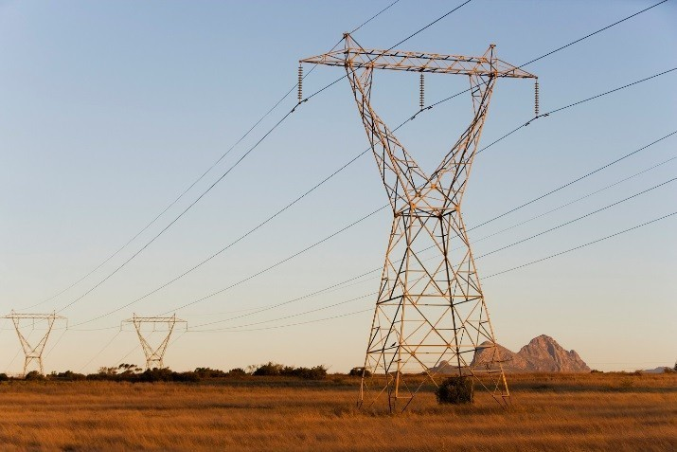
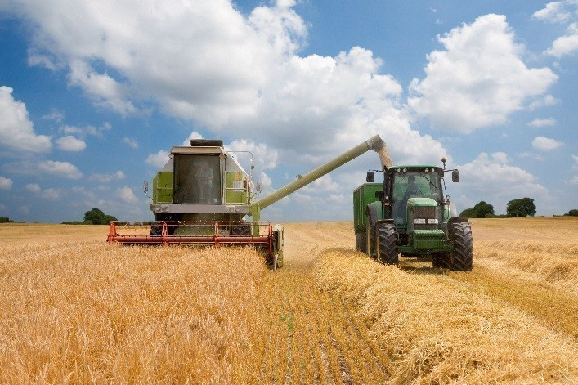


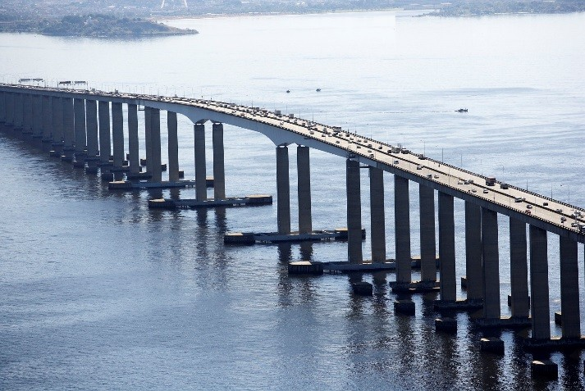
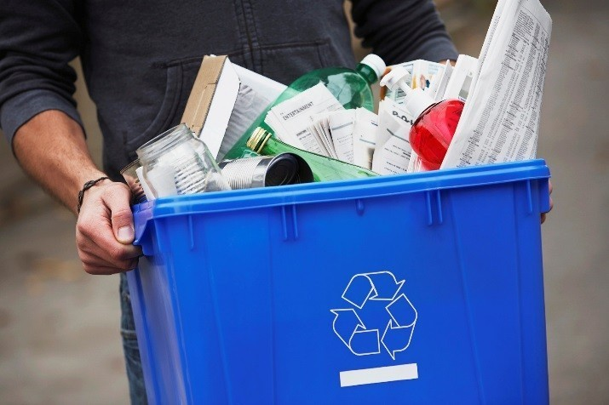
Strategic sectors analysis
2
Energy and Renewables
Pg 15
Agriculture and Agro-foods
Pg 24
Defense
Pg 34
Tourism and Hospitality
Pg 40
Infrastructure & Construction
Water and Waste Management
Pg 48
Pg 55

Slide 16
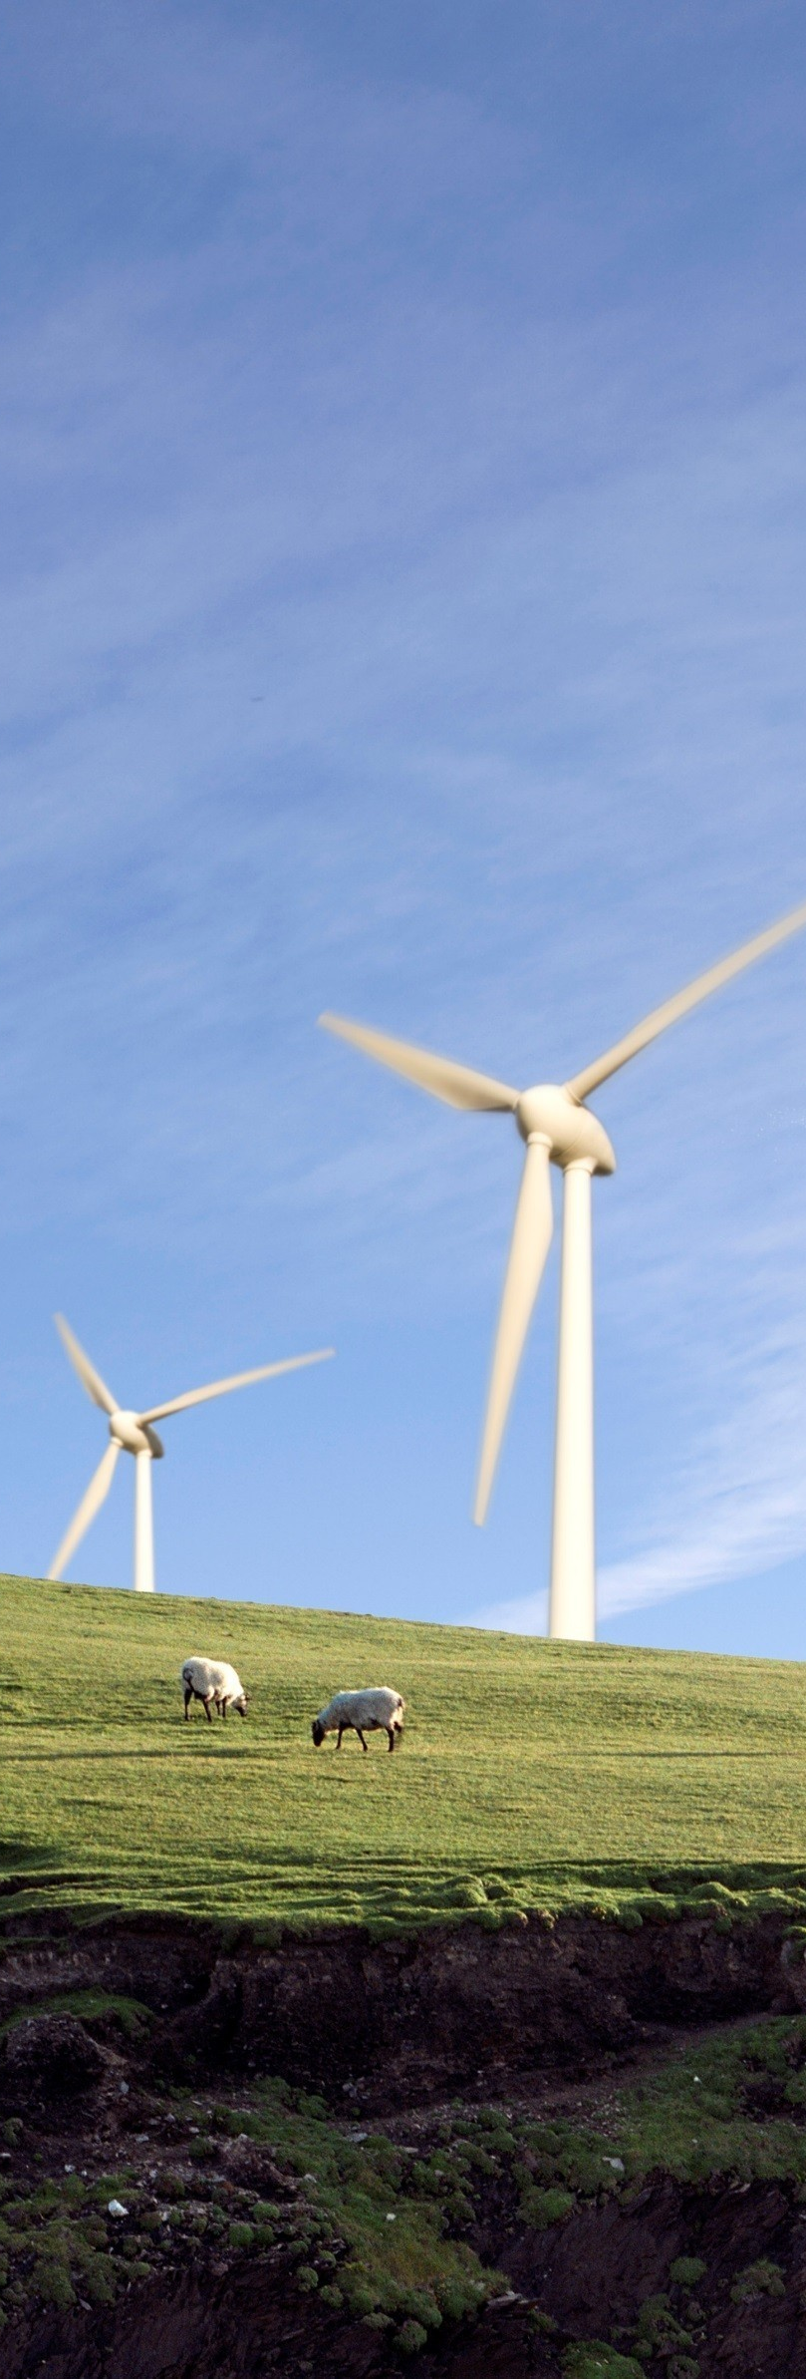
Energy and Renewables Sector
Key Indicators
+€8.1bn
Market value of electrical power production and supply in 2014 Source: MarketLine
+€2.7bn
Contribution of renewable energy to Portuguese GDP in 2013 Source: APREN
+€4.29bn
Total amount for which the Portuguese Government sold EDP and REN to Chinese investors Source: Financial Reports
61%
Of electricity produced in 2014 came from renewable sources Source: DGEG Memorandum of understanding
Signed in January 2017, between India and Portugal. It aims to promote technological innovation and the sharing of knowledge

Slide 17
Energy and Renewables Sector
Market specifics, figures and key trends
Market specifics
  Despite the recent difficult economic climate, Portugal has continued to develop and reform its energy policies. Changes have resulted in:
A new strategy (coordinated by DGEG) emphasizing renewable energy and energy efficiency is focused on meeting national and European objectives. The new strategy includes proposals to reinforce interconnections with transnational European networks, and measures to promote economic and environmental sustainability.
Key trends by sub-sectors
Electricity:
Electricity production (from non-renewable sources) and electricity supply have been liberalized. This has led to an Iberian Electricity Market (“MIBEL”) shared by Portugal and Spain.
Feed-in-tariffs (“FiT”) are awarded to producers of electricity from renewable sources. However, it has created a substantial tariff deficit. The government plans to eliminate this by 2020.
The transmission and distribution of electricity are still regulated, being operated by REN (“Redes Energéticas Nacionais”) and EDP (“Energias de Portugal”).
REN was privatized in 2012 and certified as transmission system operator (“TSO”).
EDP is leading the implementation of smart grid technology in the electrical distribution network in Portugal, through the InovGrid project.
Higher economic activity in the sector
Increased renewable energy deployment
Further market liberalization
Greater emphasis
on energy efficiency
Market figures
Natural Gas:
The natural gas sector comprises regulated and unregulated activities. The regasification, storage, transport and distribution are regulated by ERSE (“Entidade Reguladora dos Serviços Energéticos”). Sourcing and supply are (partially) liberalized.
REN was certified as TSO for the gas market.
Competition has started to emerge in the retail sector in tandem with development of the Iberian Market for Natural Gas (“MIBGAS”).
Electricity:
2014
Generation
Consumption
52,803 GWh
46,178 GWh
€3.2bn
€4.9bn
Natural Gas:
2015
Imports
Consumption
Oil:
4.1bcm
4.1bcm
Portugal has limited known (close to zero) natural oil reserves.
Portugal went from net importer to net exporter of refined oil products in the past few years.
Crude oil reserves in Portugal are regulated by the ENMC (“Entidade Reguladora dos Serviços Energéticos”), guaranteeing that oil reserves don’t fall below a minimum threshold.
The market for supply of oil products is liberalized but highly concentrated, being divided among four main players.
€0.75bn
€0.75bn
Oil:
2015
Refining
Consumption
301kb/d
260kb/d
€3.6bn
€3.1bn
Source: INE, DGEG, MarketLine and International Energy Agency

Slide 18
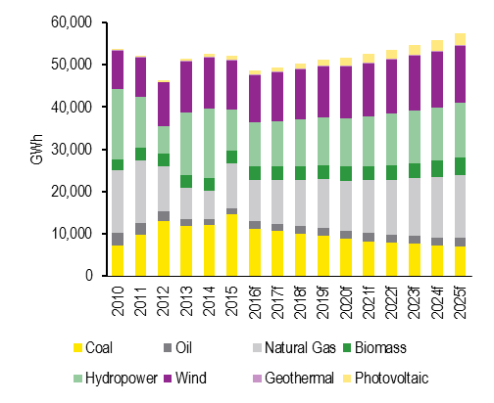
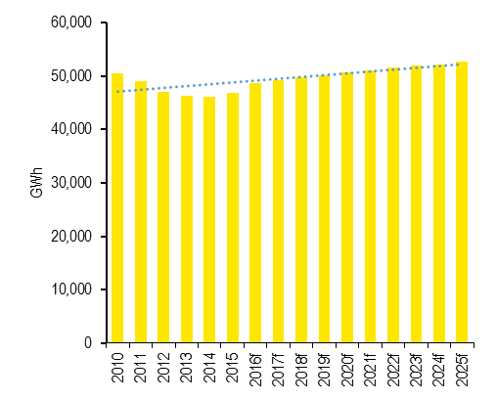
Energy and Renewables Sector
Historic evolution and forecasted growth
Electricity
  In 2014, Portugal generated 52,803 GWh of electricity (hydropower was the most used source ).
Renewables
  Portugal is a world leader in the generation and use of renewable energy. Since 1999, the Portuguese government encouraged the use of renewable power sources by i) creating a support mechanism through feed-in tariffs, ii) tax benefits and investment subsidies, iii) access to European Union funds and iv) simplified licensing procedures.
Main sources of power generation:
Hydropower
Wind
Coal
Natural Gas
31%
23%
23%
13%
Installed Capacity for Renewable Generation:
  Historically, generation of electricity has had a steady pattern, totaling approx. 50,000 GWh each year. Forecasts indicate that power generation is expected to steadily increase until 2025, at an average annual rate of 1.9%.
2008
51%
2011
51%
Evolution of power generation
2014
59%
2020
68%
2025
71%
=2,000MW
% of total capacity
Source: BMI
  In 2014, 61% of the electrical power generated in Portugal was from renewable sources with hydropower and wind energy representing more than 50%. Electricity produced from renewable sources is forecasted to continue to grow, especially from photovoltaic sources (with a forecasted CAGR of 13.5% from 2016 to 2025).
Source: DGEG (for historical information) and BMI (for forecast)
Generation by renewable source:
  During 2014, total consumption of electricity in Portugal was 46,178 GWh (with > 50% consumed by industrial and non-domestic consumers).
  Consumption of electrical power follows the same pattern as the generation. Consumption is forecasted to steadily grow up to 2025, when it is expected to reach 52,600 GWh.
Hydropower
Wind
Biomass
Photovoltaic
2008
16% | 13% | 4% | 0%
23% | 17% | 6% | 1%
31% | 23% | 6% | 1%
22% | 24% | 6% | 3%
23% | 23% | 8% | 5%
2011
2014
Evolution of electricity consumption
2020
2025
% of total production
Source: BMI
Point of View In 2016, during four consecutive days, Portugal was able to produce 100% of its required electricity using renewable sources. In a country with the highest solar exposure in Europe there is a desire to achieve energy independence. Key players are taking the right steps in a market that has a global relevance.
Source: BMI

Slide 19
Energy and Renewables Sector
Historic evolution and forecasted growth
Natural gas
  Portugal has no natural gas resources and has to import 100% of demand. Gas imports can arrive by sea, mostly from Nigeria (LNG), or from Spain (pipeline gas). In 2015, Portugal imported 4.1bcm (billion cubic meters) of gas, mostly LNG, which allowed it to generate 13% of its electricity overall.
Oil
  Portugal has little significant reserves of crude oil, and imports 100% of demand. In 2015, it imported 294kb/d (thousand barrels per day), from countries like Angola, Saudi Arabia and Algeria. The imported crude oil is domestically refined and used for consumption and exports. Portugal is a net exporter of oil products. In 2015, the country refined 301kb/d of oil products and had net exports of 44kb/d.
Natural gas imports and consumption 2015:
Main oil products refined in 2015:
Pipeline Gas
Gas imports
LNG
41%
46%
4.1bcm
54%
Gas and diesel
Refining
18%
301kd/d
Fuel oil
15%
Power generation
Industry
Oil refining
Residential
Gasoline
46%
29%
12%
7%
  Portugal has a dedicated oil infrastructure grid, which comprises of ports, refineries, pipelines and storage facilities. All crude oil imports pass through one of the two major ports in Portugal, each one connected to one refinery nearby, both owned by Galp. A major pipeline connects the larger port to the biggest storage site. There are a total of 50 storage facilities in the country, with Galp owning 84% of the storage capacity. Oil products are transported to the market by truck.
  Oil is the largest energy source in Portugal, representing 45% of the total supply of primary energy. In 2015, consumption of oil products amounted to 252kb/d, with 60% of this value being consumed by transports and 19% by industry.
  Refined products production is estimated to stay relatively stable at approx. 300 kb/d. Consumption is aligned with this production trend.
  The gas infrastructure in Portugal comprises reception, storage, transmission and distribution. The LNG terminal in the port of Sines is operated by REN. The National Natural Gas Transmission Network is also operated by REN, while distribution is provided by 11 companies with Galp and EDP as key players.
  Natural gas was mostly used by industrial consumers. Consumption decreased in the years to 2014, mainly due to a shift to other sources of energy (renewables mostly), but forecasts show an inversion in this trend.
Source: BMI
Source: BMI

Slide 20
Energy and Renewables Sector
Value chain and main players
Electricity
Production
Transmission
Distribution
Supply
EDP Produção
EDP Renováveis
ELECGAS
Tejo Energia
Turbogás
Other
REN
EDP Distribuição
Other
EDP Comercial
Galp Power
Endesa
Iberdrola
Other
Renew: Regulated
Renew. : Regulated
Fossil: Liberalized
Regulated
Regulated
Liberalized (2017)
Natural Gas
Sourcing
Infrastructure
Supply
Galp
Other
Regasification
Storage
Transport
Distribution
Galp
EDP
Goldenergy
GN Fenosa
Iberdrola
Endesa
REN
REN
Galp
REN
Galp
EDP
Sonorgás
Liberalized
Regulated
Liberalized
Oil
Refining
Infrastructure
Retail
Galp
Pipelines
Storage
Transport
Galp
Repsol
Cepsa
BP
CLC
Galp
Galp
CLC
ENMC
Galp
CLC
Liberalized
Regulated
Liberalized

Slide 21
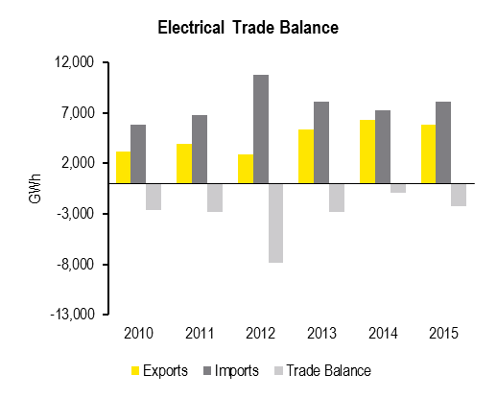
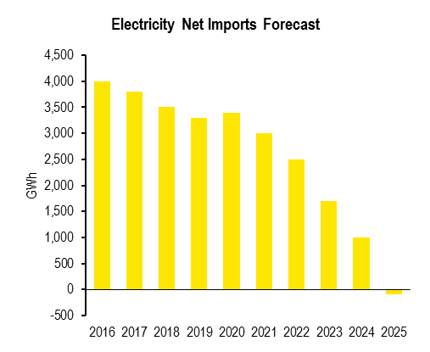
Energy and Renewables Sector
Imports, exports and trade balance
Electricity
  The Portuguese power trade balance is typically negative. In 2015, Portugal exported 5,811 GWh of electrical power and imported 8,077 GWh, resulting in a negative trade balance of 2,266 GWh. But the net trade balance has been improving.
Oil & Gas
  Portugal historically has been a net importer of oil products and this is very likely to continue in the future, even if the country is now able to export higher quantities of refined products.
Source: DGEG
Source: BMI
  Until 2025, forecasts indicate that the trade balance is expected to maintain this trend. The value of net imports is estimated to reduce progressively up to the point it becomes negative in 2025.
  The behavior in natural gas is very similar to oil as Portugal is a traditional net importer of this product.
Source: BMI
Source: BMI

Slide 22






Energy and Renewables Sector
Key players
EDP - Energias de Portugal: EDP is the biggest producer, distributer and supplier of electricity in Portugal through EDP Produção, EDP Renováveis, EDP Distribuição and EDP Comercial. EDP has a relevant presence in the world energy outlook, being present in 14 countries. The Chinese company China Three Gorges holds 21% of the company, the investment fund of UAE (IPIC) holds 4% and Qatar Investment Authority holds 2.3%.
REN – Redes Energéticas Nacionais: REN is a Portuguese company that operates in 2 major business areas, transmission in very high voltage electricity along with the overall technical management of the National Electricity System and transport of high-pressure natural gas and overall technical management of the National Natural Gas System. State Grid Corporation of China holds 25% of the company, Oman Oil Company has 15% and the Fosun International holds 5% through Fidelidade.
ENDESA Energia: Endesa is a Spanish company which operates in electricity production, distribution and supply, and also in the natural gas market, being present in Portugal mainly in the market of energy supply.
Galp Energia: Galp is a Portuguese company engaged in the production and supply of electricity, in the extraction, refining and supply of oil products and distribution and supply of natural gas.
Iberdrola – Iberdrola is a Spanish company, number one electricity company in Europe and one of the largest in the world by market capitalization. It operates in Portugal mainly in the supply of electrical power. Qatar Investment Authority holds 9% of the company.
TEJO ENERGIA - Produção e Distribuição de Energia Elétrica: Company that operates in the Pego power plant and produces electricity by usage of coal. It is jointly owned by the French Engie and the Japanese Marubeni.
Main players
Relevant company information as of 2015
€ 000 | Turnover | Total Assets | No. of employees
EDP, S.A. (consolidated) | 15,517,799 | 42,536,965 | 6,683
Endesa – Sucursal de Portugal | 987,615 | 296,627 | 7
Galp Power | 478,174 | 131,516 | n.d.
REN | 369,795 | 291,628 | 239
Tejo Energia | 220,791 | 497,734 | 13
Iberdrola Clientes Portugal | 128,809 | 58,783 | 35
Source: Annual statements and Amadeus database

Slide 23
Energy and Renewables Sector
M&A activity in Portugal
Market framework
  The energy sector has been until recently owned by the public sector. With the 2008 sub-prime crisis, which led to a sovereign debt crisis, the state sought to sell some of the stake it had in companies in the energy sector. This resulted in some of the largest transactions that took place in Portugal.
  Additionally, since 2006, due to the liberalization of the electricity market, consumers may choose their electricity and gas supplier. This led to the arrival of new players, or existing players in the energy sector which have now started operating in the electricity market, once a monopoly market. Additionally, in the renewables arena, some of the most global relevant players (like EDP Renováveis) are very active worldwide.
        Main transactions
Inversiones Ibericas sold for € 550m
Indirect investment from Caixa Galicia in Galp Energia SGPS
Iberwind Group sold for € 1.005bn
Babcock & Brown Limited buys a 100% stake from Semapa, SGPS
2005
Galp Energia SGPS sold for € 720.5m
Amorim Group buys a 14% stake from EDP
Galp (natural Gas) sold for € 844m
REN buys Galp’s natural gas business
2006
Iberwind Group sold for € 1.15bn
Magum Capital buys a 100% stake from Babcock & Brown Limited
EDP group sold for € 2.69bn
China Three Gorges buys a 21.35% stake Government of Portugal
2008
Galp Energia SGPS sold for € 534.78m
Amorim Energia and CGD buys 5% stake from ENI S.p.a.
REN, SGPS sold for € 1.55bn
State Grid Corporation of China buys a 25% stake from Parpublica, SGPS
2012
2015
Finerge sold for € 900m
First State Investments buys 100% stake from Enel Green Power Espana, S.L.
Iberwind Group sold to 2 Chinese companies: Cheung Kong Infrastructure (CKI and Power Assets Holdings
Galp Gas Natural distribuição sold for € 138m
Marubeni buys a 22.5% stake from Galp Gas & Power, SGPS
2016
EDP Renováveis sold for € 550m
EFG Hermes buys a 49% stake in 23 offshore wind farms in France, Spain, Belgium and Portugal
Future key projects in the pipeline
  In November of 2015, Portugal's EDP Renewables, France based Engie, Spanish energy group Repsol and Japan based Mitsubishi and Chiyoda, have come together to build a floating wind farm in offshore Portugal (25MW of installed capacity, representing a total investment of USD130.2m) estimated to become operational in 2018.
  The first deep water oil project in Portugal (Alentejo) received green light in 2016 to start operating in 2017. The project is envisioned to have a total investment of €90m and will be developed by a consortium which includes Galp and ENI.

Slide 24
Energy and Renewables Sector
What can India gain?
Indian reality
Key Sector
Power sector is a key sector of focus to promote sustained industrial growth
5th largest market
5th largest power generation portfolio in the world (capacity of 304.8GW – 14.7% contributed by renewable energy).
Economic growth, increasing prosperity, a growing rate of urbanisation and rising per capita energy consumption has led to increased demand for energy in the country, which creates a positive environment among investors keen to tap into India’s renewable energy potential.
Huge renewable resource availability and potential.
Ambitious target of 175 GW (100 solar, 60 wind, 10 biomass and 5 small hydro power) of renewable power by 2022, which will offer massive investment opportunities across the value chain.
India is the world’s 4th largest importer of oil, 4th largest importer of liquefied natural gas (LNG) and l5th largest importer of petroleum products. Increased use of indigenous renewable resources would reduce India’s dependence on expensive fossil fuel imports.
Large investment potential
Indian power sector has an investment potential of US$ 224 billion in next 4-5 years, providing opportunities in power generation, distribution, transmission and equipment
Foreign Investors
Enercon (Germany) Vestas (Denmark) Applied Materials (USA)
Government support 10-year tax exemption, exemption from excise duties and concession on import duties on components and equipment for solar energy projects
Strategic partnerships 293 global and domestic companies committed to generate 266 GW of solar, wind, mini-hydel and biomass-based power in India over the next 5–10 years
FDI Up to 100% is permitted under the automatic route for renewable energy generation and distribution projects
What can India gain?
As India sets ambitious targets and turns the handle on market reform to attract foreign investment, opportunities in Portugal are also being unlocked as public and private sectors work together to break down barriers. While facing their own unique challenges and opportunities, key themes emerging in both markets include the need for public-private sector collaboration to identify and overcome project and investment barriers, and the need for significant volumes of capital to accelerate the electrification agenda.
With the liberalization of the Portuguese electricity and natural gas industry, that started in 2006, it will open opportunities for new players to enter the market including Indian companies to access this high potential market.
Solar energy with high potential due to Portugal’s high solar exposure (one of the highest in Europe), new breakthroughs in the energy storage technology and government investment in this source of renewable energy from 2016 to 2019. The similarity in climates of both countries (hot and sunny almost throughout the year), provides huge possibilities of using solar energy as a major energy source offering huge potential enhancement of collaborations in this area.
The recent approval by the Indian Government of the MoU on renewable energy signed between both countries in January this year, will help strengthen bilateral cooperation as Portugal moves towards using 100% renewable energy targets. Both sides aim to establish the basis for a cooperative institutional relationship to encourage and promote technical bilateral cooperation on new and renewable issues on the basis of mutual benefit equality and reciprocity.

Slide 25
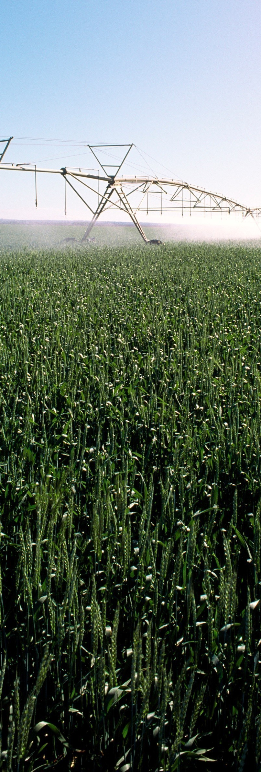
Agriculture and Agro-foods sector
Key Indicators
8.8m tons
Market volume of the food industry production Source: INE
€3.8bn
Market value of agricultural production Source: INE
1st
Place as the most valuable industry in Portugal (Food and Beverage industry) by INE Source: INE
1.8%
Percentage of the Portuguese agricultural production value in the European agricultural market value Source: MarketLine Memorandum of Understanding (MoU)
Signed in January 2017, between India and Portugal. It aims to promote the exchange of technical and scientific information, allowing access to the agricultural markets of both countries

Slide 26
Agriculture and Agro-food Sector
Market specifics, overview, size and value
Market specifics
  Activities in scope
  The agriculture and agro-food sector includes the production of goods from agricultural crops, cattle raising, fishing and food & beverage industry. It also includes production and industrial processing and manufacturing of vegetables, fruits, meats, oil crops and dairy products, among others.
  Portugal’s key crops are fruit and vegetables, predominantly because of its ideal climate for those crops. Portugal is able to produce enough volumes for own consumption and to export large quantities. Portugal does, however, have to import large amounts of grains for livestock feed for example.
  Structure of agricultural farms
  Market Size: value and volume
Agricultural Production 2014
€3.9bn
5228
thousand tons
Source: INE
Despite the relevance of cereals’ production in volume terms, the most lucrative segments were vegetables - also leader in volume - and fruit.
Animal Production 2014
€3bn
3291
thousand tons
Source: INE
Milk has relatively low market value, especially when compared to Cattle & Meat.
Very Small Farms
Large Farms
Fishing 2014
202,000
9,000
€250m
120
thousand tons
Aggregated Value:
€480m
Aggregated Value:
€2.6bn
Source: INE
  Market Overview
Marine fish is the most representative category, both in volume and value, followed by Molluscs.
Food Industry Production 2014
€8.7bn
8774
thousand tons
Source: INE
Source: INE
Taking advantage of the Mediterranean climate, the production of olive oil contributes considerably to the relevance of the Oils and fats category in volume terms. However, Meat processing takes the lead in value (23%).
Beverage Production 2014
€18.5bn
€2.6bn
3259
million litters
Source: INE
Wine is a clear leader within this sub-sector (representing almost half of the market in value terms) followed by Beer. Water bottling has low value despite its leading position in volume. The three top categories’ production is helped by the country’s weather conditions and natural resources.

Slide 27
Agriculture and Agro-food Sector
Exports, imports and trade balance
Trade balance
  In 2014, for the entire sector of agriculture and agro-food, trade balance was negative (€-2,199m). Aggregated exports amounted to €4,608m (5.9 million tons), while imports reached €6,807m (10.9 million tons).
  Animal, vegetable fats and oils, processed vegetables, fruits, dairy products and wine have the highest level of exports totaling €2.4bn..
  Meat imports represented 14% of the total. Imports of cereals, oily seeds and fruits, dairy products and fruits were also relevant, representing, together with meat, almost half of the total import value.
  When looking at the net trade balance, the most valuable products for Portugal are wine, fats and oils.
Imports
Exports
€509m, 658k tons
€436m, 459k tons
Fruits
€711m, 3,599k tons
€67m, 332k tons
Cereals
€299m, 94k tons
€400m, 357k tons
OIL
Processed vegetables
€479m, 354k tons
€525m, 343k tons
Source: INE
Animal and vegetable fats and oils
€960m, 321k tons
€214m, 92k tons
  Trade balance was negative in all sub-sectors, with the exception of the beverage industry. Agriculture and animal imports were the highest among the sub-sectors, while food industry had the highest value of exports. The beverage industry’s positive trade balance is mainly due to wine exports, which contributed to 16% of this value in 2014.
Meat
€585m, 1,000k tons
€61m, 54k tons
Oily seeds and fruits
€125m, 2,330k tons
€726m, 2,836k tons
Wine
€533m, 388k tons
€346m, 331k tons
Dairy products, eggs and honey
Source: INE
Source: INE

Slide 28
Agriculture and Agro-food Sector
Key success factors (I)
Why is Portugal successful in agriculture and agro-food?
Agriculture is part of Portuguese essence. Most of Portuguese traditions and culture are based on agriculture and primary sector processes.
Certain products that were originally used in agriculture have been able to diversify, being reinvented and have now a much broader use.
One example is the cork, of which Portugal is the largest global producer (Corticeira Amorim and Herdade do Pinheiro are two of the most relevant players). Originally, cork was used in bottled wine, but nowadays has several uses, including fashion, construction and spaceships.
Another example is the re-invented agro-tourism, where existing agro farms now also offer accommodation and other sports and entertaining experiences.
Portugal’s market is characterized by a large number of small producers, with low power. As a result of that, social initiatives produced cooperatives/farmer associations aimed at introducing scale and market power.
With regards to regulation, in the past years Portuguese strategies were linked to European directives. Some of the main measures implemented relate to establishing limits to production. An example was the imposition on the production of milk so to have competitive prices. Another example of measure implemented to keep fair prices and also guarantee land sustainability was mandatory fallow periods for larger plantations.
Portuguese government also created “certified regions” for some products. A very easy example is Porto wine region that is well delimited and protects producers by making new entries more difficult.
Public incentives were also oriented to key regions and products. Another example is young farmer incentives, directed to young unemployed populations. This is valid mostly for rural areas left to abandonment and/or with high young unemployment. It proved to be very important both to bring youngsters and natality higher levels back to these regions and give to young entrepreneurs conditions to be self-employed.
These measures allowed to bring innovation to this sector with the use of new products and technologies.
Technology depends on knowledge, meaning that in order to use it, it is necessary to train personnel. Every year in Portugal around 1.3 thousand students finish their degree in agriculture related fields. This represents around 2% of the graduates and more than 28 thousand since 1994. Indian universities may forge exchange programs with Portuguese universities in order to expand their know-how.
Universities in Portugal are also vey well connected with entrepreneurs and companies in order to obtain new technics and develop ideas to improve quality and productivity. In recent years, these partnerships developed many Apps and technologies that made the process more efficient.
Consumer behavior change was also a significant part of the success of the Portuguese agro-food story. “Portuguese products are the best” or “Choose Portugal” were campaigns launched that had real effect in consumer behavior patterns. Today, when a Portuguese consumer goes to a market, he/she will be aware of which products are Portuguese or not and will take an informed decision.
Differentiated cultures and products. Portugal is a small country, this means that it can not rely on quantity. Quality and value must be the drive for success. This reality brought two main trends (i) Organic and/or exotic cultures, (ii) technological improvement.
Consumer behavior and highly qualified young producers, combined with increasingly available incentives, created willingness for non-traditional products in Portugal. Examples of these products are medical plants, red fruits, tropical fruits. This was only possible with the remarkable technological developments and support .

Slide 29
Agriculture and Agro-food Sector
Key success factors (II)
Why is Portugal successful in agriculture and agro-food?
In 2015, for the sixth consecutive year, the Food & Nutrition Awards distinguishes Portuguese companies for agro-food innovation, research, health and education..
Another drive for partnering discussions is the certification, quality and food regulation compliance. Portugal is a pioneer or ‘’first rider’’ for many European countries. A long path has been trailed to restructure the industry in order to comply with national and EU standards. This know-how can be shared through partnerships between both countries.
Cost efficiency is crucial in this sector. Companies and farmers are constantly affected by electricity and water costs. Today’s trend is to turn these costs as efficient as possible. Renewable energy is being used as an alternative, and it is a good solution given that for example solar energy is produced when most of the work is performed. Another commodity that is being rationalised is water. Sophisticated irrigation systems are used in order to achieve a sustainable production.
Compost production is a priority in the Indian Waste Management program. Portuguese players as “TERRAFERTIL” have the necessary skills to deal with all the process since collection, to treatment and residual cleaning.
Aquaculture also allows for interesting business partnering opportunities between Portugal and India. Portugal already collects many success cases, for example in biological production (successful example of The "Algarve Offshore Seashells" concession, owned by Testa & Cunhas, SA). Currently, the company is dedicated to the biological production of the native mussel species (Mytilus spp), using structures suspended in the water column (long-line). The company has plans to start the production of oysters, scallops and clams.

Slide 30






Agriculture and Agro-food Sector
Key players
Elaia: Elaia is a joint project between Sovena group and Atitlan Investments, focusing on the growing and exploitation of olive groves. The company operates in Portugal, Spain and Morocco, having 8.5 thousand hectares of planted olive groves in Portugal.
De Prado: De Prado is a Spanish company focused on the production of farming products, livestock and olive growing. It is a family-run company, still owned by family members, dedicating its activity in Portugal mainly to the exploitation of olive groves.
Euroeste: Euroeste is a Portuguese company operating in the agricultural and animal production sector, focused specially in breeding pigs. The company trades in other seven countries, such as Brazil and Angola, and has been founded in 1986.
Sociedade Agrícola da Quinta da Freira: Portuguese company dedicated to the breeding of poultry meat. Belongs to Valouro Group, which is, through its subsidiaries, specialised in all activities related to poultry, including breeding, processing, packaging and distribution. Other relevant companies of the group are Avibom, Kilom and Ovo D’Ouro.
Sovena: Sovena is one of the largest olive oil producers in the world. The Portuguese group is specialised in olive oil, developing all activities from the growing of olive trees to the distribution of olive oil and being divided in 4 sub-companies: Agriculture (that includes Elaia), Oilseeds, Consumer Goods and Biodiesel. Sovena Consumer Goods is responsible for the production and refining of olive oil. The group holder is Nutrinveste, a company in the consumer goods sector held by Jorge de Mello.
Lactogal: Lactogal is a Portuguese company dedicated to the production and sale of dairy products. The company owns 7 factories in Iberia, holding brands such as Agros, Mimosa, Mtinal, Vigor or Primor.
Portugal Fresh: It’s an association of producers that aims to promote fruits, vegetables and flowers from Portugal, both internally and internationally.
Quinta da Serra and Quinta do Pedro Cavada – These two wine producers are owned by the Angolan General Kopelipa.
Central Frutas do Painho – is a company held by Angolan capital (Tzhizé dos Santos) in the fruits business.
Main players
Relevant company information as of 2015
€ 000 | Turnover | Total Assets | No. of employees
Agriculture
Elaia | 56,500 | 274,974 | n.a
De Prado Portugal | 47,244 | 119,389 | 148
Lusomorango | 37,726 | 4,265 | 6
Hortafina | 31,437 | 9,872 | 52
Vitacress Portugal | 24,345 | 29,459 | 275
Animal Production
Euroeste | 74,139 | 37,811 | 96
Sociedade Agrícola da Quinta da Freira | 56,006 | 31,357 | 211
Norte Aves | 45,743 | 29,314 | 86
Ovo D’oro | 37,974 | 13,703 | 318
Hiperfrango | 36,543 | 16,736 | 8
Food Industry
Sovena Portugal – Consumer Goods | 886,654 | 294,200 | n.a.
Lactogal | 867,397 | 522,407 | n.a.
Nestlé – Portugal | 448,150 | 344,451 | n.a.
Unicer Bebidas | 411,854 | 258,130 | 872
Sumol + Compal | 341,277 | 624,064 | n.a.
Source: Amadeus; Company financial reports

Slide 31
Agriculture and Agro-food Sector
M&A activity in Portugal
Market framework
  The agriculture and animal production sector in Portugal have a reduced number of big producers and a large number of small producers, although the latter usually work as part of cooperatives to compete against the large ones. However, in recent years, the average size of farms has increased, as well as the level of corporatisation, contributing to the increase in the sector’s efficiency, through economies of scale and application of professional business models.
  The food and beverage industry in Portugal is the largest industry in the country, representing 15% of the sales value of industrial products. It is dominated by large firms, well established in the market for a long time and belonging to groups that usually hold some or all upstream activities, and sometimes downstream ones as well.
        Main transactions
Proyecto Tierra sold for € 91m
Elaia bought the oil producer from Spanish-based company Deoleo
SAPJU Carnes sold to Lino Vicente group
Rafael & Filho sold the meat producing company
2010
ECS Capital acquires 86% of MIF
PE acquires a stake in the meat producer, now called Montalva
Tate & Lyle sold sugar refinery
American Sugar Refining bought the refinery in Lisbon
2011
Africalimentar stake sold
Primor Charcutaria-Prima acquired 50% of the meat manufacturer
Saludães stake sold for €6.4m
M101 bought 55% of the rice producer from Deoleo
2012
Panicongelados stake sold for € 20m
Espirito Santo Capital and Caixa Capital acquired 32% of the company from Panigest
Montebravo sold to ECS Capital
Frozen food producer acquired through Montalva
Panicongelados bought back
Private equities sold the 32% share back to Panicongelados
2013
Sumol+Compal Marcas stake sold for €88m
Copagef acquired 49% of the brand from Sumol+Compal
Imperial sold to Vallis
PE fund acquired the chocolate maker from RAR
2015
Panicongelados sold
Oxi Capital acquired the company
Campotec IN sold for €4m
Oxy Capital acquired the vegetable producer
Atlantic Meals 50% stake acquired
Maicerias Espanolas bought a stake from the rice and corn processor
NovoDia Cafés acquired
Riberalves sold the coffee producer to Newcoffee Co.
2016
SAPJU carnes acquired by Campicarn
Saltiproud sold the company
Sortegel sold
SDEL acquired the nuts processor
Mondelez factory sold
Cerealto Siro Foods acquired the biscuit factory from Mondelez Portugal
Source: Mergermarket; Company financial reports

Slide 32
Agriculture and Agro-foods Sector
What can India gain?
Indian reality
Key Sector
Agriculture and associated sectors’ GDP was $244.74 billion in FY16, it contributes 16% of GDP and represented 10% of export earnings
2nd largest land
At 157.35 million hectares, India holds the second largest agricultural land in the world
Agriculture is the mainstay of the Indian economy, providing employment to 52% of its workforce. The agriculture and food processing sector plays an instrumental role in augmenting the growth of the economy, as it is an important source of raw material for the industrial sector.
India is the largest producer of spices, pulses, milk, tea, cashew and jute.
It is one of the largest manufacturers of farm equipment accounting for nearly one-third of the overall tractor production.
Agriculture and related sectors recorded a growth of 6.6% CAGR during FY07-16.
4th largest exported commodity
Agricultural product is the 4th largest exported main commodity with a share of 10% of total exports
Foreign Investors
Kraft (USA) Mars (USA) Nestle (Switzerland)
Government support Food processing is recognised as a priority sector in the new manufacturing policy from 2011. 100% tax exemption for first 5 years. Nil excise duty in milk, dairy products, vegetables, nuts & fruits- both fresh and dried.
Strategic partnerships MOUs/Agreements have been signed with 52 countries. No. of partnerships with other countries have reached 63.
FDI 100% is permitted under the automatic route in food processing industries. 100% FDI is allowed through government approval route for trading, including through e-commerce in respect of food products manufactured or produced in India.
What can India gain?
Portugal and India are very strong in industry verticals such as agro products and fisheries. Both countries realise that a combined effort can bring about the full potential. Both have complementary economies and can take advantage of being part of different regions and markets.
Portugal is a country of excellence for the production of olive oil due to its Mediterranean climate, with typically warm and dry areas being ideal to olive trees and one of the top 3 olive oil producers worldwide (e.g. Azeite Galo, Sovena). India's plan to become a leading olive oil producer can be met by access to Portugal’s market.
Bilateral Trade has been growing steadily during the past few years, however during FY14-15 the % growth fell by 11.43% with total trade standing at US$692.2m. Major export items include cotton and fish.
Portugal’s agricultural performance has re-emerged becoming the fastest growing and alternative sector to create more jobs in the country. Agriculture farms can be the best destination for young Asians.
Job opportunities for skilled agricultural, forestry and fishery workers to reach 23% by 2025, which is 6% higher than forecasted by the EU as a whole, creating opportunity to invest in the sector.
There was significant untapped potential for bilateral cooperation in agriculture, food processing and related sectors. This realisation prompted a Memorandum of Understanding between both countries (January 2017) to instigate collaboration in these areas, with the objective of accelerating phytosanitary certification of animal products and vegetal origin from both countries, enhancing two-way market access, investment, technology cooperation and exchange of expertise. To facilitate this, regular exchanges and cooperation between regulatory authorities of both countries are expected to take place..

Slide 33

Defense
Key Indicators
€2.5bn
Portuguese Defense expenditure in 2014
1.45%
GDP allocated to Defense expenditure
250
Number of companies included in the national Defense Technological and Industrial Base (DTIB)
5th
Position in the Global Peace Index . Memorandum of Understanding
Signed in January 2017, between India and Portugal aimed at increased cooperation in the area of Defense and covering matters such as: (i) high level visits; (ii) cooperation at operational level; (iii) education and training
Source: European Defense Agency ‘EDA’
Source: EDA
Source: AICEP
Source: Global Peace index

Slide 34
Defense Sector
Industry and main KPI’s
Defense main KPI’s
€2.5bn Total Defense expenditure, out of which:
€2.0bn Personnel expenditure
€2.5m Infrastructure expenditure
€343m Equipment procurement expenditure
€2.4m Defense R&D expenditure, which has increased by 177% since 2013
€157m O&M expenditure
1.45% of Defense Expenditure as % of GDP
2.95% of Defense expenditure as % of total government spending
€241 Defense expenditure per capita
€550k European Collaborative Defense research and technology ‘R&T’ Expenditure
457 Troops deployed, corresponding to 1.5% of total military personnel
7,878 Deployable land forces, corresponding to 26% of total military personnel
1,818 Sustainable land forces, corresponding to 23% of total military personnel
Defense industry
Legal framework
In Portugal, companies or entities that wish to entry the industry of military goods and technology must be previously authorised and must comply with certain requirements.
Furthermore, after being granted presence in the industry, companies that want to export/import, must comply with the specifications and request authorisation to import and export Defense-related products.
Activity in 2014
The trading’ value of military goods and technologies reached €529m.
In 2014, 23 applications for access’s authorisation to the industry of military goods and technologies were received, and only 13 were authorised.
As of December 2014, 130 companies had authorisation to participate in this industry.
Trade balance
Portugal is characterized as a peaceful country, being the 5th most peaceful country in the world, according to the Global Peace Index.
When compared with other EU countries at a similar Peace’s rank, Portugal stands as a ‘spender’ country, contributing to a higher percentage of the GDP in National Defense expenditure.
Mainly communication
Exports
€157m
Imports
Mainly components
Source: EDA
€353m
Countries | Global Peace Index (GPI) Rank | Defense expenditure as % of GDP
Austria | #3 | 0.76%
Portugal | #5 | 1.45%
Czech R. | #6 | 0.96%
Slovenia | #10 | 0.98%
Finland | #11 | 1.33%

Slide 35
Defense Sector
Innovation and technology (I)
Innovation in Defense
Main trends affecting the sector include:
The modernisation of Defense forces;
The increasing awareness of cyberattack threats.
Portugal’s national strategy has taken into account the above trends and sets as main goal ‘to value knowledge, technology and innovation’. One of the key priorities of the Portuguese Defense is the promotion of research, development and innovation as a mean to reach a higher technological development in the Defense and the development of an integrated and competitive Defense Technological and Industrial Base ‘DTIB’.
Latest developments
Objective: Develop Radio Systems for unmanned aerial vehicles (UAV's) starting 2015.
Players involved: IT Aveiro – Instituto de Telecomunicações, Critical Software, PT Inovação e Sistemas, FCUL, CEIIA, CIGeoE e CINAMIL.
Funding: €1.2m (Ministry of Defense).
In 2014, a consortium which included a number of Portuguese companies was selected by the European Defense Agency and received a government grant.
Objective: ‘To provide a proof of concept for an innovative system aimed at improving soldiers’ indoors building awareness by introducing in buildings miniaturised sensors which can move and change position to provide better coverage and improved performance.’ Starting in 2016.
Players involved: TEKEVER, IT Aveiro – Instituto de Telecomunicações, Aralia and the Bulgarian Defense Institute.
EDA Grant: €433k.
DTIB clusters and players
Defense Technological and Industrial Base (DTIB)
The DTIB is a network of companies and entities with ‘the ability to intervene in one or more stages of the Defense system and equipment life cycle’.
The Portuguese platform for Defense industries ‘idD’ was created with the goal of promoting and developing companies’ activity in the Defense sector. The national DTIB focus areas include:
Research and development
Production
Modernisation
Maintenance, repair and modification, demilitarisation and disposal
Results from the joint effort of the Ministry of National Defense, the Ministry of Economy, the Armaments and Infrastructures Directorate, the Offsets Permanent Commission, AICEP and other relevant entities in the industry.
The network includes 250 companies organised in clusters (aeronautics, textiles, automation, robotics, construction, engineering, software development and others).
DTIB has a small dimension and includes mainly SMEs. According to AICEP, in recent years, there has been an effort to consolidate and strengthen the capacities of the DTIB, reducing duplications of efforts and inefficiencies.
For more information on the companies associated, please refer to http://btid.iddportugal.pt/
Project TROANTE
Project SPIDER

Slide 36
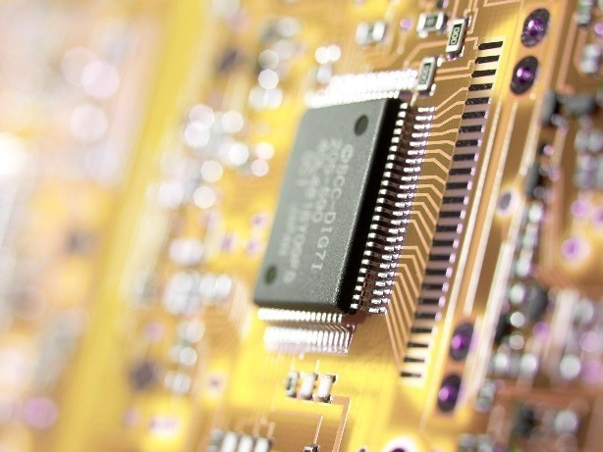
Defense Sector
Innovation and technology (II)
Latest developments
Objective: To reinforce the capabilities of national underwater surveillance using passive detection of illicit activities of both surface and submerged ships off the coast of Portugal. Starting January 2016.
Players involved: Instituto Hidrográfico da Marinha e Força Aérea, Marsensing and CINTAL.
Funding: €1.2m (Ministry of Defense).
Objective: To create an intelligent system to enable crisis’s response operations. Starting January 2016.
Players involved: Marine, Army, Critical Software, ISEGI and Unidemi.
Funding: €423k (Ministry of Defense).
Objective: To develop new uniforms/garments with higher resistance to impact, cut and to drill. Starting November 2016.
Players involved: Air force, Army, Tecminho, Leandor Manuel Araújo, Fibrauto, Latino Confeções, IDT Consulting and Sciencentris.
Funding: €696k (Ministry of Defense).
Objective: To create a system for dissemination and sharing of multilevel information between military or civil entities. Starting October 2016.
Players involved: INOV-INESC, Marine, Air force, and Xsealence.
Funding: €332k (Ministry of Defense).
Objective: To develop a management platform of resources and operations for military operations and for emergency operations and distress. Starting January 2016.
Players involved: AMN, CINAMIL, CINAV, Critical Software and INESC-ID.
Funding: €1.2m (Ministry of Defense)
Portugal is also involved in other projects, namely at the EDA level, including:
Joint Investment Program – Unmanned Maritime Systems (JIP-UMS)
Submarine Application for the Managing of a Battery System (SAMBAS)
Swarm of Biometric Underwater Vehicles for Underwater ISR (SABUVIS)
As mentioned previously, in January 2017, India and Portugal signed a Memorandum of Understanding on Defense Cooperation. The document sets out the intention to hold high-level meetings, to hold naval exercises of opportunity, to establish exchanges of training and research and to carry out work on other subjects of common interest in international security and Defense industries.
Please note that India also implemented a platform for Defense industries called DRDO – Defense Research & Development organization - which is a network of more than 50 laboratories, deeply engaged in developing Defense technologies covering various disciplines.
Project SUB.ECO
Project BMS & EMM
Project THEMIS
Project AUXDefense
Project ANDROMEDA

Slide 37
Defense Sector
Key players
DTIB Key players in Defense
Company | Turnover (2015) | Description
OGMA – Indústria aeronáutica de Portugal, S.A. | €159.3m | Included in the Aerospace cluster. Founded in 1918, is a worldwide player in the aerospace manufacturing business. The main shareholder is Airholding – SGPS, SA (owned by Embraer Netherlands – SGPS, SA).
Critical software | €27.6m | Included in the Aerospace cluster. Founded in 1998, is specialised in the development of software and engineering solutions for critical systems for security and business. The main shareholder is Critical SGPS, S.A.
Tekever | €27.2m | The Group's activities are organised in the Information Technology and the Aerospace, Defense and Security Divisions, that focus on researching, developing and delivering technology, products and services for the international market.
Indra Sistemas Portugal, S.A. | €20.9m | Included in the Cybersecurity cluster. Operating in Portugal since 1997, provides technological solutions for the Defense sector. The main shareholder is Indra Sistemas, S.A.
EID – Empresa de investigação e desenvolvimento | €18.6m | Included in the ITC cluster. Global supplier of high technological solutions for the Defense and Security industry. The main shareholder is Thunderwaves, S.A.
Arsenal do Alfeite | €16.6m | Included in the Naval cluster. Is a shipyard with capacity for building and repairing vessels (surface or underwater). The main shareholder is Empordef – Empresa Portuguesa de Defesa, SGPS, S.A.
Edisoft | €9.4m | Included in the Naval cluster. Provides software and engineering solutions for Naval systems and Maritime security. The main shareholder is Thales Portugal, S.A.
Deimos Engenharia (Group Elecnor) | €3.9m | This company delivers advance design solution and turn-key space software systems focused in areas such as mission analysis, guidance, navigation and control etc.
Sodarca – Sociedade distribuidora de armas de caça, Lda | n.d. | Sordarca Hunting and Fishing, as the name indicates, have two large fields of business.
Eurofiresafe | n.d. | Eurofiresafe specialises in the development of all types of PPE used by the Armed Forces and Civil Protection Agents
Source: Amadeus

Slide 38
Defense Sector
What can India gain?
Indian reality
Strategic Sector
Defense is a strategic sector.
1.7% - 1.9% of GDP
Historically, Defense expenditure was of approximately 1.7% - 1.9% of GDP, of which 36% was for capital acquisitions. Only about 35% of Defense equipment is manufactured in India.
India is taking steps towards a more open collaboration and a more competitive and investor friendly Defense environment India is currently looking for:
R&D support
Capital infusion
Technological transfers
The call for Defense players in India is to become partners in “Make in India” initiative rather than remaining exporters. These steps are materialized in the following points.
Private participation private players can now get involved in manufacturing of Defense equipment and technology
Strategic partnerships with key private players will enable capacity creation in targeted sub-sectors
Industrial licenses Easier and more transparent process for obtaining licenses and with longer validity periods (from 3 to 15 years
3rd largest military force
India is considered to be the world’s 3rd largest military force and has the world’s largest volunteer army.
$35bn
FY16 Defense budget was of roughly $35bn and is expected to grow at a CAGR of 10% in the next 5-7 years.
What can India gain?
India is investing in a more collaborative, competitive and investor friendly approach. Portugal has got a long history of collaboration between national and international authorities and also between public and academic entities with private companies. Such knowledge-base and mindset may strengthen the institutional relationship between the two countries, complementing and enabling strategic partnerships between companies from both sides.
Portugal has been investing significantly in technological development and now reached a point of maturity. India could gain with the transfer of technology (“ToT”) through JV and partnerships.
India is to increase its naval base up to 212 warships by 2027 (from 140). Portugal has always been deeply connected to it’s naval history an legacy, and the evidence of that is that there are more than 300 companies in Portugal’s naval industry dedicated to shipbuilding and repairs, naval communications and R&D. Most of these companies have experts, dimension and technology that add value to any investor.
The Indian army has been granted $60bn capital budget for the next decade. Partnerships with Portuguese companies might be sought in areas such as: battle field management systems, tactical communications systems. On the other hand, there are also many projects funded by the Portuguese Ministry of Defense in order to develop cutting-edge technology in systems and communications. This meant that Portuguese companies are now well prepared to develop technology that aims to be used in most advanced military forces in the world.

Slide 39

Tourism and Hospitality
Key Indicators
16.3m
Tourists (hotel guests, both local and international) in 2015 Source: INE tourism report
€29.2bn
Total Travel & Tourism (‘T&T’) GDP contribution in 2015 Source: World Economic Forum
333k
Direct T&T employments in 2015 Source: World Economic Forum
19m
Number of guests in 2016 Source: Turismo de Portugal

Slide 40
Tourism and hospitality
Market specifics, indicators and impacts
Main KPIs
It is difficult to set the boundaries between what is ‘’touristic activity’’ and not. As such, one has to establish a delimited market to better analyse Portugal’s key indicators in this industry.
Market specifics
The impact of the Travel and Tourism sector on Portuguese GDP has been increasing and it’s expected to follow the same trend until 2026. In 2015, direct contribution was €11.3bn and total contribution €29.2bn.
The impact of the sector in jobs’ creation is also increasing significantly.
.
The tourism trade sector is historically a net exporter and has been able to strengthen its position in the national trade balance.
€29.2b vs €11.3bn
Total contribution¹ to GDP in 2015, (corresponding to 16.4% of total GDP) vs direct contribution¹ to GDP in 2015, (corresponding to 6.4% of total GDP)
883k vs 363k
Total jobs created by the tourism sector in 2015 (19.3% of total employment) vs direct¹ jobs in the same year. According to T&T Council, ‘’total jobs’’ was forecasted to increase by 3.7% in 2016 and to reach 1m jobs in 2026. Direct jobs are forecasted to grow by 4.6% in 2016 (reaching 8.2% of total employment). By 2026, direct jobs are expected to reach the 441k figure.
€14.1bn
Money spent by foreign visitors (or visitors exports) in Portugal in 2015
€2.4bn
Capital investment attracted in 2015 by the travel and tourism industry. By 2026, the share in total national investment is expected to have increased by 10.4%.
84% Leisure spending
Weight of Leisure spending in Tourism and travel (“T&T”) contribution to GDP of World Travel and Tourism Council. Business spending is only 16%:
66.4% Foreign spending
According to World Travel and Tourism Council, most of the GDP comes from foreign visitor spending (66.4%). While domestic spending is forecasted to grow to €7.3bn in 2016 and to €8.6bn in 2026; foreign visitor spending will reach €18.6bn in 2026.
Source: World Travel and Tourism Council
¹Total contribution includes the wider impacts on the economy, namely the GDP impact and jobs supported by T&T Investment spending, government collective spending, purchases by sectors dealing directly with tourists and spending by those who are directly or indirectly employed by T&T sector.
Source: PORDATA

Slide 41
Tourism and hospitality
Market segments and main KPIs
Market segmentation
Based on Banco de Portugal (“BdP”), tourism sector includes the following segments: i) transports and logistics, ii) accommodation and iii) leisure.
Transport and logistics
The number of passenger movements at airports is consistently increasing year on year, leading to an increase on revenues associated with tourism.
However, in the case of ports, the increase in both landed and on board passengers was offset by the decrease in number of passengers in transfer.
Accommodation
In 2016, all indicators show an increase both in volumes and value.
Consistently, number of guests is increasing (either because there are more or because they stay longer) and are paying more for their accommodation.
Leisure spending
The leisure spending segment ranges from maritime touristic trips to guided tours to museums and historical monuments. Activities are highly influenced by seasonality (with June, July and August being the most important months).
According to Turismo de Portugal, the following indicators reflect the current size of this segment:
Demand for leisure touristic activities is equally split between national and international demand (54% of international demand in 2014). The international demand comes mainly from UK, Spain and France.
Passenger Movement
2.729 companies |  | 11%
Companies in tourism entertainment, including 763 companies operating as maritime tourist operators |  | 11% of the companies had more than 10k clients in 2014
23% |  | 51%
23% of the companies in tourism entertainment reported a turnover above €100k in 2014 |  | 51% of the companies had a positive turnover growth in 2014
Source: Turismo de Portugal, 2016
Number of Guests
9,8%
Number of Overnights
9,6%
2015
2016
2015
2016
17.3m
19m
48.9m
53.5m
Source: Turismo de Portugal, 2016
63.6%
€42.6
 | Occupancy Rate | Revenue per Available Room
Growth (2015-2016) | 3% | 5%

Slide 42
Tourism and hospitality
Key success factors (I)
Key global trends
Higher access to information (products and prices) and consequently higher bargaining power of tourists
Increasing demand for digital platforms for the acquisition of tourism solutions
Better informed tourists resulting in higher requirements and higher levels of expectations from tourists
Higher frequency of short and city breaks, increasing sales in the low season
Healthy consciousness destination selection
Increasing demand for destinations that include adventure, well-being or fitness facilities
Demand for healthcare and wellbeing destinations
Emerging economies as new destinations
No repetition of destinations, experiences or products due to limited budgets
Higher competition between suppliers
More travels to visit relatives and friends, as well as business trips, due to the globalisation effect and Portuguese openness to international cultures
Many efforts were made in order to put Portugal on the map. Since 2013, the strategy changed, the country was able to adapt to the global megatrends and emerge as a sustainable ‘’wild card’’ in the global tourism sector. One key area where the country invested was on digital marketing.
Portugal as a brand – Sitting within the Ministry of Economy, Turismo de Portugal is the National Tourism Authority responsible for promoting, enhancing and sustaining tourism activity, adding in one entity all the institutional competences related to the promotion of tourism, from supply to demand. From 2007 to 2014, the amount invested in promoting Portugal tourism, internally and externally, totaled €93bn.The return of this investment was an increased brand awareness in international markets.
Additionally, there was a segmentation of the different offers each region puts forward, so that Portugal can offer a wide range of experiences to visitors (ranging from the traditional beach, to history lovers, foodie lovers, radical holidays, health minded, etc).
The wellbeing and health tourism is impacting other areas such as urban life and revitalisation of historical city centres. One good example of this is “Project Revive”.
Project Revive – Portuguese government plan to rehabilitate 30 derelict public historical buildings (monasteries, convents, castles, etc.). Through public tenders, private entities are able to operate these buildings under concession terms (transforming them into hotels, museums or restaurants). The total investment resulting from this project is expected to reach €150m. This project started at the end of 2016 and will continue in 2017. So far, only one concession was granted – went to Vila Galé for the regeneration of São Paulo convent. This will be a 40-years’ concession for hotel services and involves €5m investment.
Technology
Culture
Economy
Why is Portugal so successful in tourism?
The success of tourism in Portugal always seemed a long distance away. Key players in the sector were sure of their potential but years passed and Portugal (except for the Algarve) was not being able to appear on the map for worldwide tourists. Nevertheless, the vision was there, and in small steps, internal preparations were made.

Slide 43
Tourism and hospitality
Key success factors (II)
Which were the enabling factors?
Business Environment (“BE”) – without a good BE, private initiative is not going to grow. Portugal is 57th in the rank which was also a result of the recent simplification reforms. This fresh and recent know-how on best practices can add value to India.
Safety and security (“S&S”) – this factor may be the most important and also more challenging to obtain. Portugal ranked #10 and India #129. India could benefit from the awareness of the population concerning the importance of tourism and of tourist safety. It is important to understand that this gap might not only shrink the traditional tourism but it will have a significant impact in new ways of tourism as “AIRBNB” and similar trends.
Health and Hygiene (“H&H”) – although health may not be the first think someone thinks when is going on holidays, the same is not true for hygiene. India ranked #83 concerning improved drinking water, whereas Portugal is #1. This is an issue that clearly may be a great opportunity for partnerships between both countries. More about Water and Waste management in the equivalent chapter.
Human Resources and Labour Market (“HR&LM”) – again there are opportunities for India to learn with what Portugal is doing well. Many initiatives were taken by public entities in order to qualify workers, for example the “Senior Tourism Academy” oriented to qualify people of more than 55 year old that were unemployed; or training for younger people promoted by “Escolas de Hotelaria e Turismo” and suported by the “Plano Estratégico Nacional do Turismo” (PENT).
ICT Readiness – the quality of internet and electricity supply are important aspects for the majority of tourists and even for investors.
Infrastructure - In addition to what’s included in the infrastructure chapter, and with a big impact on this sector, the largest low cost airlines (like EasyJet and Ryanair) fly to different locations in Portugal, which made the cities of Lisbon, Porto and Faro even more accessible.
Portugal also has a very well developed network of ATMs (one of the most developed in the world) which was the result of the strategy implemented by SIBS.
Incentives – Another key factor are all the benefits the government and relevant local authorities are giving, trough more flexible legislation around different types of accommodation, or incentives to people that wanted to requalify abandoned buildings in historical centers.
Natural and Cultural Resources – Despite Portugal Portugal is able to offer a wide range of experiences and type of holidays, ranging from beach, to skying, hiking, walking as it has a very rich set of natural resources.
The current strategy for the sector has the purpose of providing a strategic framework and an integrative approach to investment options and sector policies.
Main priorities of the Strategy include (i) adding value to the offer, (ii) boosting the economy, (iii) enhancing knowledge, (iv) improving connectivity and (v) creating awareness.
As a result of this vision, Portugal is now a competitive country for Travel and Tourism. In fact, World Economic Forum ranked Portugal in its “Travel & Tourism 2015 Competitiveness Index” (“T&T CI”) as #15 in 141 countries analysed.
Natural and Cultural
Resources
Enabling Environment
Infrastructure
T&T Policy and Enabling
Conditions

Slide 44




Tourism and hospitality
Key players (I)
Main players – Accommodation
Vila Galé: Vila Galé is one of the biggest Portuguese hospitality groups, being part of the 207 biggest groups within this sector in the world. Operating since 1986, the group manages 27 hotels (20 in Portugal and 7 in Brazil), with a total of 6,410 rooms and 13,068 beds and employs 2,500 people.
Grupo Pestana: Founded in 1972, Grupo Pestana owns 88 hotels and approximately 10,000 rooms. Growing through internationalisation, the group is already present in Portugal, UK, Germany, Brazil, Argentina, Venezuela, Mozambique, South Africa, Cabo Verde, São Tomé e Príncipe, USA, Cuba, Morocco, Colombia and Spain. Employs 7,000 people.
United Investments: United Investments Portugal is part of the IFA HR consortium for the development of Sheraton Algarve Hotel, Pine Cliffs Ocean Suites, Pine Cliffs Resort. UIP recently acquired Sheraton Cascais Resort (previously known as Vivamarinha Hotel & Suites).
Accor Hotels: Is an international service group based in France, operating in hospitality, travel, catering and casino management branches.
Relevant company information as of 2015
€ m | Turnover | Total Assets | No. of employees
Vila Galé | 118 (2014) | 239 (2014) | 2,500
Grupo Pestana | 62 | 322 | 417
United Investments | 51 | 197 | 417
Source: Amadeus; Company financial reports

Slide 45




Tourism and hospitality
Key players (II)
Main players – Tourism transports and logistics
Transportes Aéreos Portugueses: Founded in 1945, the Portuguese carrier airline is headquartered at the Lisbon airport. Operates to 88 destinations around the world. It has as shareholders the Portuguese State (39%), and Atlantic Gateway SGPS, Lda. (61%).
ANA – AerPortos de Portugal: ANA is Portugal’s airports authority and is part of Vinci Airports Group since 2013, managing 10 airports in Portugal.
NA – Netjets Aviation / Netjets – Transportes Aéreos: Company based in Oeiras, specialised in private aviation solutions. Part of NetJets Europe, the company has the control of approximately 100 planes and operates 66k flights per year.
Leaseplan Portugal: Leaseplan (part of the Dutch group LeasePlan Group) started its operations in the Portuguese market in 1993 and operates in the sector of vehicles leasing and fleet management. Currently has 98,000 vehicles under management.
Relevant company information as of 2015
€ m | Turnover | Total Assets | No. of employees
TAP | 2,329 | 1,892 | 7,356
ANA | 545 | 2,400 | 1,270
NA – Netjets Aviation | 461 | 89 | 168
Netjets – Transportes Aéreos | 384 | 61 | 254
LeasePlan Portugal | 199 | 882 | 119
Source: Amadeus; Company financial reports

Slide 46





Tourism and hospitality
Key players (III)
Main Players – Tourism and operators
Viagens Abreu: Founded in 1840, Viagens Abreu is one of the biggest travel agencies in the country and owns 150 offices that sell travel services for all destinations. The company has 1500 employees and organises one of the biggest tourism fairs in Europe for final consumers. It is a family business.
Soltour (Grupo Pinero): Soultour, part of Grupo Pinero, is a family business and one of the biggest Spanish tour operators and has a representation in Portugal.
Travel store: Travelstore – Business solutions group is a multi-channel platform that operates in Portugal, Spain and Africa, targeted at business/executive trips. It is owned by Embraer and a private equity.
TUI Portugal: Travel agency, the international group, provides services in Portugal, including car leasing, tours, guides, transfer services and others.
Viagens El Corte Inglés: Vigens El Corte Inglés is a Portuguese branch of Viajes El Corte Inglés SA (which is part of Grupo El Corte Inglés, one of the biggest business groups in Spain). Viajes El Corte Inglés currently owns 700 stores, being present in Portugal, France, Italy, Mexico, Argentina, Chile, Peru, Colombia, Panama and others.
Relevant company information as of 2015
€ m | Turnover | Total Assets | No. of employees
Viagens Abreu | 464 | 112 | n.a
Grupo Pinero | 54 | 8.7 | 12
Travel Store | 49 | 18.5 | 163
TUI Portugal | 46 (2013) | 43.7 | 145
Viagens El Corte Inglés | 47 (2014) | 7.7 | 119
Source: Amadeus; Company financial reports

Slide 47
Tourism and hospitality
M&A activity in Portugal
Market Framework – Accommodation and travel agencies
  Both the travel agencies subsector and the accommodation subsector are characterised by the coexistence of a few main entities (companies from international groups and many smaller entities like hostels, local lodgments in the case of the accommodation segment).
  The M&A activity in the last years has been different in the two subsectors. There is a record low number of transactions in the travel agencies subsector, while recently in the hospitality subsector there are many valuable transactions.
        Main transactions
2010
Companhia Iberica de Turismo Global acquired a 49.01% stake in Intervisa Viagens
Pavo Garden acquired Probiurbe for €15m
Enotel acquires Turifonte
Gescat Llevant acquires Lusort Luxury Resort
2011
HPP Saúde acquired a 65% stake in Carlton Life Boavista
Pavo Garden acquired a 55% stake in Soberhouse for a consideration of €11m
Frotimo (subsidiary of Barraqueiro) acquired Recitur for €5m
MGM Pvt acquired Petchey Group of Companies (Portugal and Spain) for a consideration of €50m
2012
Flagworld acquired Falperra
Sonangol acquires Atlantida for €38.56m
Explorer acquires Dolce CampoReal, a stake of 97.52% in ITMR and a 96.65% stake in Ecotur
2013
ECS acquires CS Hotels
Discovery Real Estate Management acquires Aquapura Douro Valley
Grupo Queiroz Pereira acquires SODIM
2014
Algarve Property Limited acquired Vale do Lobo Resort
Top Atlantico acquired by Nautalia for €8m
Citirama’s 49% stake acquired by Barraqueiro for €6m
Shark broker has acquired a 99.95% stake in Albatroz
Oxy Capital 3 hotels and a casino from Amorim Turismo for €153m
Geostar is sold to Sprinwater Capital
2015
Minor Continental acquired Tivoli Lisboa, Tivoli Marina Vilamoura, Tivoli Marina Portimão and Tivoli Carvoeiro for€117.7m
Amorim Turismo acquired by a Spanish bidder
The Fladgate partnership acquires The Vintage House Hotel from ECS Capital
Grupo AFA acquires Savoy Resort for €115m
Oxy Capital acquires Quinta das Lágrimas
2016
Fundimo acquires a Property of Pestana Carlton
Oxy Capital aquires Hotel da Praia S.A.
Minor International aquires Hoteis Tivoli, S.A and Marinoteis S.A. for €87.5m
The Fladgate partnership aquires Hotel Infante Sagres
Source: CapitalIQ and mergermarket

Slide 48
Tourism & Hospitality Sector
What can India gain?
Indian reality
Key Sector
Emerged as one of the key growth drivers among the services sector
Global Tourism & Travel competitive index
Moved up 13 positions to 52nd from 65th
Tourism is also a potentially large employment generator (13.5m jobs - Restaurants (10.5m), Hotels (2.3m) and Travel Agents/Tour Operators (0.7m) besides being a significant source of foreign exchange (3rd largest sector - US$1.9billion).
Rising middle class and increasing disposable incomes has continued to support the growth of domestic and outbound tourism. Online hotel bookings expected to grow due to the increasing penetration of the internet and smart phones.
Launch of several branding & marketing initiatives by the government such as “Incredible India!” and “Athiti Devo Bhava” to provide a focused impetus to growth.
GDP contribution
7.5% of the GDP, total contribution in 2016 is c US$136 billion, expected to grow at 5% CAGR during 2016-26, and to reach US$280.5 billion by 2026
Road Ahead
Expansion of E-visa scheme expected to double the tourist inflow, India is projected to be the fastest growing nation in the medical tourism sector in the next 5 years, clocking over 20% gains annually
Government support Government plans to exempt homestays from service tax or commercial levies and make their licensing process online, which is expected to encourage people to offer homestays to tourists, Budgetary support of US$2.8billion in 12th 5-year plan, 5-year tax holiday for 2, 3 & 4 star hotels located around UNESCO World Heritage sites
Strategic initiative Government of India covered 150 countries under e-visa scheme in 2015
FDI 100% through automatic route, US$9.2billion of FDI during 2000-2016. Among top 10 sectors to attract FDI, US$126billion capital investment required by 2025
What can India gain?
Portugal has initiated a Golden Visa scheme to attract non-European investors. The first major foreign investor under this scheme was an Indian Hotelier, who invested EUR 50m in 3 hotels in the Algarve region and was awarded the Golden Visa and Resident permit by Portuguese Foreign Minister in 2013.
In 2014, India was among the top 5 countries for inbound tourism into Portugal. Portuguese delegations have visited India to promote it as a leisure destination. Architectural restoration, hotel industry, tourist services, maintenance of heritage sites and tourism infrastructure are potential sectors for bilateral collaboration.
Portugal has “gone digital” concerning tourism marketing, this technic has shown to efficient for tourist attraction in a smart way. With segmented and directed marketing Portugal was able to “customize” the offer to the tourist, to bring down the seasonality and to show exactly what they want to. This approach is part of a shared vision both of Portuguese government and Turismo de Portugal. India can replicate this strategy with the help of these players.
“Low cost”, the budget airlines brought a lot of passengers to Portugal. It is easy to come to Portugal and Portugal made sure that it was easy to like it. Budget airlines are an efficient way to bring people, this example can also be replicated by India.
Portugal has many schools dedicated to Tourism services, partnerships could allow Indian students to go to Portugal or Portuguese teachers to go to India in order to share their knowledge and to launch new programs.
There is a gap in India’s Tourist service Infrastructure, ATM network may be improved with the help of SIBS, to name an example. Hotel rooms may also be created with partnerships with accommodation players listed in previous pages.

Slide 49

Infrastructure and Construction sector
Key Indicators
4%
Estimated weight of the construction’s Gross Value Added (GVA) on the Portuguese’s total GVA
€16.8bn
Construction’s industry value in 2015
90%
Of the industry’s value came from residential and non residential segments
€17.7bn
Expected industry’s value for 2020 .
Source: INE and PORDATA
Source: Marketline
Source: Marketline
Source: Marketline

Slide 50
Infrastructure and Construction Sector
Market specifics, size and value
Market specifics
  The Infrastructure and Construction sector in Portugal includes the residential segment (houses and similar work), non-residential (commercial, industrial, social and similar work) and civil engineering (infrastructure for transportation, telecommunications, energy, and others).
  Historically, this sector had a strong impact in the Portuguese economy. In 2001 it represented 8% in of the country GVA. However, due to recession that started in 2008, its weight decreased to 4% in 2015.
  This trend was highly impacted by the restrictions the government had recently in public spending, namely in large infrastructure projects.
Market value
  Portugal’s construction sector value in 2011 was €19.0bn but declined to the current €17bn.
  Residential and non-residential were the segments that generated more value, both accounting for €7.5bn, representing 90% of the sector’s value in 2015.
  .
  Civil engineering suffered the most due to its dependency on public investment. As a result, many Portuguese internationalized to emerging countries, such as Angola and Mozambique in Africa and Central and South America.
  In 2012, external markets represented 20% of total turnover of the sector.
Source: Marketline
Source: INE and PORDATA
Source: Marketline
Point of View This track record allowed Portuguese companies to become familiar with the hurdles of internationalization and to gain a robust experience in large infrastructure projects in different markets in different stages of development.
Source: Base website

Slide 51
Infrastructure & Construction Sector
Roads and ports concession model
Concession model in Portugal
  Another key feature of this sector in Portugal is the use of Public-private partnership (“PPPs”). PPPs became quite used in Portugal over the last 15 years in areas such as highways, ports, water and hospitals.
  These agreements allowed the state to develop key infrastructure for the population with the transfer of the investment to private companies, who build and operate the asset under a concession for a certain period of time for a fixed remuneration. In Portugal, concession period is usually 30 to 40 years, depending on the size and cost of the infrastructure.
  As presented below, in 2013 maritime transport was the most used way of transport for Portuguese exportations in volume, and has a significant weight in terms of value.
  Roads (highways)
  Portugal had in 2015 over 3,100 km of highways, with concession to 16 entities. These entities are responsible for maintenance and conservation of the roads.
  The main players identified are:
  EP – Estradas de Portugal
  Brisa SGPS with 6 concessions
  Ascendi, with 7 concessions
Source: INE, Statistics on international trade in goods
  Portuguese container market has grown significantly since 2009, mainly driven by expansion of the Port of Sines, reaching 2.5m TEU (twenty foot equivalent units) in 2014.
  Currently, the majority of the Portuguese construction companies is selling their stakes in the companies holding the concessions (mostly in highways) as a way to refinance their business.
Ports
  Portugal’s coast line is extensive, with a 943km length, which is significant when taking into account the size of the country. Along the coast line there are nine commercial ports, five of which constitute the main port system, with the remaining four representing the secondary port system.
  Portugal is placed in a strategic location, at the intersection between the North-south route and the East-west route.
  As presented below, in 2013 maritime transport was the preferred way of transport for Portuguese exportations in volume, while in terms of value, it showed a significant relevance.
Source: IMTT
Point of View The experience Portuguese companies had with these projects in Portugal, allows them to replicate the some modus operandi in other markets and benefit from their expertise in the creation and negotiation of the terms of these agreements, together with the management of the investment and operation phases.

Slide 52
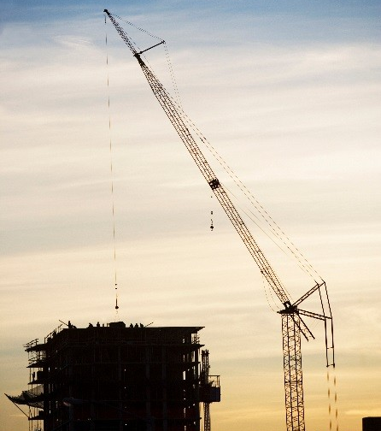
Infrastructure & Construction Sector
Expectations for the future
  xxxxxxx
Industry’s forecasted value
  As stated previously, public investments are scarce, and it is likely that private sector will be the motor in the development of infrastructure and construction projects. Sector ‘s projections estimate a value of €17.7bn by the end of 2020.
  State annual budget
  The main public investment projects considered in the 2017 budget are in the following areas:
  Railroads - Construction of new railway lines, covering a length of 214 km, and the modernization of existing lines, of about 900 km, having a global investment of €2.7bn.
  Roads - Continue the plan established in 2016, to implement priority interventions for the local highway, favoring infrastructural requalification and increased circulation of vehicles and pedestrians.
  Airport system - Construction of a new airport in the Lisbon area (Alcochete) is expected to begin in 2019, as a solution for the development of future airport capacity in the Lisbon metropolitan area.
  Hospitals – Three new hospitals expected to begin construction in 2017 in Lisbon, Seixal and Évora.
Source: Marketline
  Juncker plan
  The Juncker Plan (the European commission’s investment plan for Europe, announced in 2014) aims to stimulate €315bn of new investments in Europe. Since it became operational in the summer of 2015, it has funded projects which, together with private investment, amount to almost €46bn, of which €25bn for innovative infrastructures and investments and €21bn for SMEs, through InnovFin Horizon 2020. In Portugal, the Juncker Plan has already provided bank guarantees of approximately €42m, which will allow €588m of new investment to the benefit of 590 SMEs and startups.
  This plan may represent a significant boost in the construction sector and will allow funding for multiple projects in the areas of urban regeneration, infrastructure, social housing (new construction and rehabilitation)

Slide 53


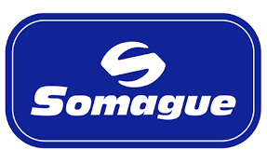




Infrastructure and Construction Sector
Key players
Teixeira Duarte - Is one of the largest Portuguese construction companies operating in the world. It is also present in several sectors such as concessions and services, real estate, hotel services, distribution and energy.
Mota Engil - Leader in Portugal and with a consolidated position in the ranking of the 30 largest European construction groups, Mota-Engil is currently present in 22 countries, spread across 3 geographic areas - Europe, Africa and Latin America. Participating in more than 200 companies.
Somague - Is a group of Portuguese companies that operate in the areas of engineering and railway and port construction, water and energy concessions, and real estate.
Zagope - Is a company specialized in Public Works owned by the Brazilian Group Andrade Gutierrez, with activities in the Engineering and Construction, Concessions, Telecommunications, Energy and Health Services sectors.
Brisa - Brisa Auto-Estradas has more than 40 years of activity and is the largest transport infrastructures company in Portugal and one of the largest international motorway operators. Brisa also owns 60% of Via Verde.
Via Verde, company that owns the automatic tolling system enabling a better traffic-flow along with convenient billing system. Via Verde is present in 2,100km of highways, 94 parking lots and 101 petrol stations. Its main share holder is Brisa.
Construtora do Tâmega – is a company in the construction sector, operating in several countries besides Portugal such as Angola, Mozambique and Cape Verde. This company is held by Angolan shareholders (António Maurício).
Main Players
Relevant company information as of 2015
€ 000 | Turnover | EBITDA | No. of employees
Teixeira Duarte | 656,580 | 36,611 | n.d.
Mota Engil Construção | 601,658 | 40,250 | 2,092
Somague | 426,688 | 12,115 | 1,923
Brisa | 31,685 | (31,731) | 2,158
Source: Financial statments

Slide 54
Infrastructure and Construction Sector
M&A activity in Portugal
Market framework
  Overall, the construction industry is quite fragmented, even though the largest players represent a significant part of the market. There are multiple buyers, from governments to individual consumers, with the governments having more relevance. Suppliers comprise sub-contractors and providers of construction materials. Although the capital barriers to entry into the industry are not significant, to be able to compete in the large contracts market it is required that companies offer a wide range of services. There has been a consolidation/restructuring process in the sector, as a consequence of the crisis the sector and key players faced.
  Main transactions
Cimpor, SGPS, sold by € 968m
Camargo Correa, S.A. buys a 22.17% stake from Teixeira Duarte
2010
2011
Cimpor, SGPS, 21.2% sold by € 784m
To Intercement Austria Holding
Cimpor, SGPS, bought by € 3.1b
Camargo Correa, S.A.buys a 39.06%
2012
Brisa-Auto Estradas de Portugal, S.A, sold by € 4.2b
Tagus Holding Sarl buys a 50.43% stake
2013
2014
Mota Engil SGPS spinsoff its business in Africa
Amounting in € 230m
Tertir sold by Mota Engil SGPS and Novo Banco
Bought by Yildirim (Tukey) for € 335m
2016

Slide 55
Infrastructure and Construction Sector
What can India gain?
Indian reality
Key Sector
Infrastructure is the key focus area of government to achieve the economic progress.
Market potential
2nd largest road network (4.87 million kilometer) 4th largest railway length (65,808 kilometers) 3rd largest electricity producer (1.2m GWh)
India is termed as a growing and developing economy and to sustain the economic development India has been focusing and spending on infrastructure, which accounts for c.10% of GDP during 2012-17 government plan. Currently the government is targeting an investment of US$ 376.53 billion in infrastructure over a period of 3 years.
Infrastructure and construction are one of the key sectors for the development of Indian economy with consistent focus being given by the government to their development and progress.
Government initiatives and budgets:
Focused to increase airway and road connectivity through setting 50 new airports in the next 3 years and 5 expressways.
Infrastructure companies allowed to raise ECB (External Commercial Borrowings) to an extent of US$ 750 million for a minimum maturity period of 5 years.
Promoting hybrid private public partnership model to increase know how and operational efficiency.
Consistent focus to increase basic urban infrastructure for urban development.
Huge investment potential
Indian has an investment potential of US$ 455bn in the infrastructure sector.
Government support Tax exemptions and holidays of 100% being provided to facilitate the development of the infrastructure sector such as power, road and highways. Grants to an extent of 40% is provided from case to case for road and highways. FDI Relaxation in the rules of FDI and 100% FDI allowed in the construction sector under automatic route. Budget allocation Infrastructure sector allocation of US$ 33.07 billion during the last budget (2016-17).
Foreign Investors
Silver Spring Capital Management (Hing Kong) Japan International Cooperation Agency (Japan) CIDBI (Malaysia)
What can India gain?
India, a growing economy, and Portugal, a country recovering from the economic crisis of 2008, looking for deeper economic cooperations through enhancing trade and investment opportunities.
India and Portugal share similar priorities for the development of economic, financial, investments and employments, where both the countries can partner for mutual benefits into various sectors such as infrastructure relating to roads, ports and waterways.
With the bilateral agreement signed between India and Portugal in January, 2017 on various pacts, the cooperation between the countries has the potential for enhancements to other sectors including Infrastructure. India's investment into Portugal's infrastructure will enable access to new market and know how models.
A simplified tax and law procedures and investor friendly economic environment for foreign investors, well developed physical and IT infrastructure, low cost labor and utilities create a favorable business environment to set up a business in around 46 minutes in Portugal; compared to 89 days in India. Portugal is a service based economy and the market for construction and engineering are all set to expand with the number of initiatives and tax benefits provided by the government.
Portugal has set up “Aicep Portugal Global”, an agency for investment and foreign trade, to facilitate and promote business environment to invest in Portugal. The entity provides assistance to companies, including Indian companies, to set up base in Portugal, facilitate flow of information about business possibilities in Portugal. It has also launched the Golden Visa residence programme, which is a simple and fast track residence permit programme to attract foreign investment into the country.
Investing in Portugal not only opens the opportunity to enter into European common market but also to other closely connected countries like Brazil, Mozambique, Macau and Angola.

Slide 56
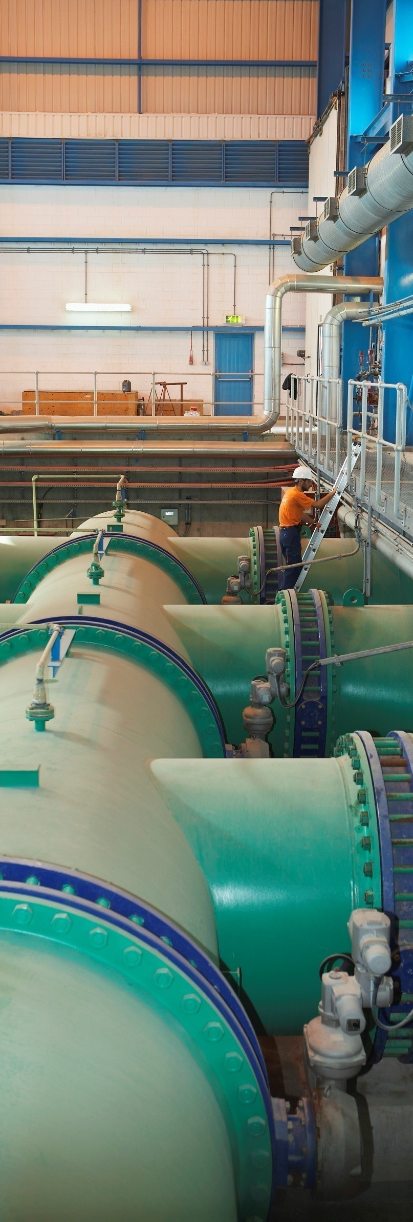
Water and Waste Management sector
Key Indicators
95%
Of households were covered by public water distribution in 2012 Source: ERSAR
€1.4bn
Municipal solid waste market value in 2014 Source: INE
4.47m tons
Municipal solid waste generated in 2014 Source: PERSU 2020
58%
Share of Municipal solid waste treated in 2014, from 38% in 2010 Source: ‘Relatório estado do ambiente 2015’ .

Slide 57
Water and Waste Management sector
Water waste and distribution
Market specifics
  Waste management comprises five main areas: i) water waste and distribution (sanitation), ii) municipal solid waste (MSW), iii) industrial waste, iv) hospital waste and v) agricultural waste.
  Water waste and distribution
  In Portugal, the state has a significant role in the sanitation, taking responsibility over i) political decision making, ii) regulation, iii) national water grid authority, iv) inspection, v) guarantees and vi) concessions.
  For each area described above there is an associated public entity in charge.
  Sanitation services are provided in Portugal by Águas de Portugal SGPS (‘AdP’). AdP is state owned and managed by: Parpública, SGPS, S.A. and Parcaixa, SGPS, S.A.
  AdP is present in all of the water cycle stages. It is also responsible for the water waste treatment in water treatment plants.
Market quality and size evolution
Source: ERSAR
The Portuguese market experienced a very positive evolution due to the large investments made by the government in reliable infrastructure. As a result, in 2012, approximately 96% of the population had access to public waste water supply. Equally, the quality of the water available was of very good quality and covered almost the entire population (98%).
Finally, as it can be seen above, almost 100% of the water collected is treated which again contributes to a much safer and with high quality water and waste treatment system.
  In 2012, water distribution and waste water treatment had an overall turnover of €1.6bn, most of which was originated in collection, treatment and distribution (€1.4bn):
Source: Report “Sector Português da água” by Águaglobal
Source: ERSAR

Slide 58
Water and Waste Management sector
Solid waste management and recycling (I)
Market specifics and size
  Solid waste represents all types of solid waste generated by households and retail. Daily volumes below 1,100 liters / establishment fall under the responsibility of the municipality for collection purposes. Municipalities are responsible for collection, transport, recovery and disposal of waste, including the supervision of such operations, and maintenance of disposal sites.
  By the late ‘90s, MSW management in Portugal had oversight of the collection of waste and its disposal in over 300 dumps distributed throughout the country, at least one for each municipality.
  After the implementation of the Strategic Plan for Municipal Solid Waste (PERSU), approved in 1997, the majority of the dumps were closed and were built new treatment facilities, for recovery and final disposal of waste. Unlike dumps individually managed by a single municipality, the new infrastructure is used simultaneously by several municipalities.
  Besides the Ministry of the Environment, which is the entity responsible for all waste legislation, and the Municipalities, there are two other types of organizations in the waste management system: i) SGRSU’s (Municipal Waste Managing System),
  structures of human resources, logistics, equipment and infrastructure, established to carry out operations related to the management of Urban Waste; and ii) SPV which is the Portuguese Green Dot System responsible for recycling packaging wastes.
  In 1994, with the establishment of the municipal waste management system, Portuguese market went from 257 small companies to 23 urban waste management systems: 12 Multi-municipal and 11 Inter-municipal:
  Multi-municipals SGRSU’s are entities whose system is managed by companies that up to 2015 had to have publicly-owned majority shareholdings;
  Inter-municipals SGRSU’s comprise municipalities or associations of municipalities.
  In the European Union about 2.7 billion tons of waste are produced annually, which is equivalent to 5.2 t / (capita/year). Of all waste generated in 2010, 53% on average were recovered while the remaining 47% were eliminated, mainly through landfill.
  In Portugal, MSW generation peaked between 2008 - 2010, at 5.2m tons, while the following years showed a decrease back to 2002 values (4.4m tons). The generation per capita follows the general trend, reaching 452 kg/year/capita in 2014.
Source: PERSU 2020
When comparing the MSW generation by regions, this is higher in more developed and populated regions, namely in Lisbon & Tagus valley and in the North which together represented 70% of the total MSW generation in 2014. MSW can take several ends as can be seen in the graph below.
In 2014, the decree law 96/2014 establishes that from 2015, SGRU’s may be exclusively or largely owned by private entities.
Source: State of environment report 2015

Slide 59
Water and Waste Management sector
Solid waste management and recycling (II)
Market specifics and size
  Landfill, despite being the most detrimental solution to the environment it is still one the most common ways of waste disposal, despite a decrease in 2014, when compared to 2010. This is explained not only due to new techniques of landfilling, such as sanitary landfill, which is less harmful to the environment, and enables energy recovery through biogas, but also due to the increase of mechanical and biological treatment.
  Recycling has become a reality in Portugal for only 20 years, after the creation of Sociedade Ponto Verde (SPV) in 1996. Two decades ago there was still no talk of packaging waste recycling, a habit that today is already part of the daily life of almost three quarters of the population. Over 20 years, 6.8 million tons of waste were recycled through SPV.
  The first kick on recycling was given with a law based on a Community directive entitling companies for the responsibility of the management and final destination of waste. This is when the SPV has come up made by a group of companies which had already financed € 600 million in packaging recycling - and € 42 million in consumer awareness and educational campaigns.
  In 1998, about 1,500 tons of packaging were sent for recycling. Seven years later, almost 385,000. In 2010 more than 667,000 and in 2015, approximately 730,000.tons of packaging were recycled.
Source: Sociedade Ponto Verde
Source: State of environment report 2015
Typical solid waste treatment chain
Organic
Waste
Selective Waste
Indiscriminate Waste
Waste collection
Transportation
Recyclable materials Sorting
Organic transformation
Energy recovery
Reuse of steel slag
Landfilling
Outputs
Recycled materials
Organic compound
Energy
Aggregate
Point of View Portuguese legislation defined specific requirements to be had in dumps, this implied that many of them had to close and encouraged their concentration in a smaller numbers. This brought many benefits. India could learn from this example. Portugal promoted waste segregation by powerful citizen education, campaigns on the recycling need, and by using colour containers which stayed in people memories better. This is the starting point for waste management and such experience may be of value to India. SPV was created by joined forces of companies that benefit with the recycling outcome, India can replicate this example by finding companies that may be interested. Portugal segmented the waste management cycle by public entities and private companies, this process is now more efficient and benefits all.

Slide 60
Water and Waste Management sector
SWM market value, trade balance and strategic guidelines
Market value
  Data from INE indicates that the aggregated turnover of companies operating in waste management sector, namely collection, treatment and disposal and material recovery, reached €1.4bn in 2014. In the same year, jobs associated with these activities within those companies, amounted to 14k.
  Trade balance in 2014
61k tons
57k tons
1,925k tons
919k tons
  Hazardous waste Non-hazardous waste
Source: Relatório estado do ambiente 2015
  Of the 1,986k tons of waste that entered Portugal, in 2014, 99.7% was redirected to recovery operations, while only 5k tons were destroyed.
  In 2014, imports came mainly from the United Kingdom (44%), Gibraltar (20%), Spain (15%). Portugal’s waste exports go mainly to Spain (91%).
Source: INE
Target metrics
  In Portugal, there are two programs that provide the framework and strategic guidelines for waste management activity: PERSU and the European Union’s 7th Environment Action Program.
  Provisions on waste generation establish there must be a reduction on the waste generated per capita of 7.6% and 10% (when compared to 2012) for 2016 and 2020, respectively.
  Recycled materials must increase at least 50% by the end of 2020.
  At least 70% of the packaging waste produced must be recycled by the end of 2020.
  Until July 2020, MSW accepted in landfill must be reduced by 35% of the total weight allowed in 1995.
  Almost 50% of total market value is represented by material recovery. Although turnover originated from collection has remained relatively stable throughout the years, treatment & disposal and material recovery have shown a significant decrease. Overall, the total turnover shows a small decrease in 2012 to 2014 explained by the decrease of waste generated.
Trade balance
  Waste transfer between European Union members and also other countries is regulated by the European Parliament. Waste circulating within the EU comply with different legal procedures, according to the dangerousness level and end - recovery or disposal.

Slide 61



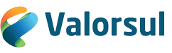


Waste Management Sector
Key players
Águas de Portugal SGPS - The main activity of the AdP Group is the management of the urban water cycle and grid, comprising all its phases: from abstraction, treatment and distribution of water for public consumption to the collection, transport, treatment and rejection of urban and industrial waste water.
SUMA - Is the result of the strategic association of fifty companies with a wide and distinctive performance in national and international territories in the field of integrated waste management, allowing to reinforce and reconcile competences in their sphere of intervention and offer multiple solutions in the life cycle of waste. It is owned partly by Mota-Engil and other investors.
EGF - Is an European holding company of reference in the environment sector and leader in the treatment and recovery of waste in Portugal. EGF is 95% controlled by SUMA.
Valorsul – Is the multi-municipal company responsible for the treatment and transformation of the approximately 950 thousand tons of urban waste produced, per year, in 19 Municipalities of great Lisbon and the west region. Valorsul’s main shareholder is EGF.
Lipor - Is the inter-municipal entity responsible for the management, transformation and treatment of Urban Waste produced by eight municipalities in great Porto.
Tratolixo - Certified intermunicipal company responsible for the public service’s treatment treatment of Urban Waste produced by more than 800,000 inhabitants of the four municipalities it operates in.
Resinorte - The multi-municipal system for the sorting, collection, recovery and treatment of municipal solid waste in Central North. Resinorte’s main shareholder is EGF.
Main players
Relevant company information as of 2015
€ 000 | Turnover | EBITDA | No. of employees
Águas de Portugal | 669,900 | 285,300 | 3,253
Suma | 169,300 | 50,790 | 6,006
EGF | 167,490 | 53,381 | 1,774
Valorsul | 58,795 | 18,416 | [open]
Lipor | 36,552 | 14,802 | 194
Tratolixo | 32,457 | 9,028 | 240
Resinorte | 20,426 | 10,322 | 226
Source: Financial statements
Note: please note that the information is presented on a stand-alone basis and that there are different % of ownership between some of the companies presented above.

Slide 62
Water and Waste Management Sector
M&A activity in Portugal
Market framework
  The Portuguese waste management market is characterized by the diversity of players offering a full services range, from logistics to industrial. Led by the largest operators, such as Suma and EGF, a phase of market consolidation started to occur in recent years and is expected to continue in the future. Stimulated by the revival of the Portuguese economic activity and by efforts undertaken by the Portuguese government towards the increase of waste treatment, as well as the ambitious metrics set to be reached by 2020, it is expected that the waste management sector will grow in the coming years.
  Main transactions
2006
Parpublica buys a 5.37% stake in Águas de Portugal SGPS
From Caixa Geral de Depósitos
Constantino bought for € 61.2m
Explorer II (PE fund) bought an undisclosed participation
2007
2008
Verdeoculto SGPS SA buys ETSA Group for € 59.9m
AmbiMed Group sold for € 15.5m
to Stericycle Inc buys
2009
EGF, SA sold for € 149.9m
Mota Engil (through Suma) and Urbaser buys a 95% stake from the Government of Portugal
.
.
.
2015
2016
EGEO, sold for a n.d. amount
To Finertec, SGPS

Slide 63
Water and Waste Management Sector
What can India gain?
Indian reality
62 million tons per year
Solid waste produced in India. It is expected to increase to 165m tons in 2030
75%-80%
Only 75-80% of the waste is collected. And only a quarter is treated and processed.
Although this is a considerable issue in India, this sector is has not developed properly in India, and there is still a lot to do.
The Union Ministry of Environment, Forests and Climate Change recently (2016) launched new Solid Waste Management Rules. These will replace the Municipal Solid Waste (Management and Handling) Rules from 2000, which have been in place for the past 16 years.
These rules cover plastic, e-waste, biomedical, hazardous construction and demolition waste. The main topics are:
Segregation at source
Collection and disposal of sanitary waste
Collect Back scheme for packaging waste
User fees for collection
Waste processing and treatment
Promoting use of compost
Promotion of waste for energy generation
Significant opportunity
All these waste also represent a significant opportunity to energy generation
$13.62 billion
Value estimated for waste management in India – how much it will be worth in 2025.
What can India gain?
Our understanding is that to provide quality urban services on a sustainable basis in Indian cities, the need of the hour is that urban local bodies enter into partnership agreements with foreign players, either through joint ventures, private sector partners or through other models.
In the past, Portuguese legislation defined requirements to be had in dumps, this made many unsanitary dumps to close and promoted their concentration, what brought many benefits. India could gain with this example close unsanitary dumps and seek for support of Portuguese entities defining requirements, to build fewer dumps with larger capacities and design their operations.
Portugal promoted waste segregation by incisive citizen education, campaigns on the recycling need and value by also using color containers. This was the starting point for waste management and this experience may be of value to India.
SPV was created by joined forces of companies that benefit with the recycling outcome, India can replicate this example by finding companies that may be interested. Portugal segmented the waste management cycle by public entities and private companies, this process is now more efficient and benefits all. Portuguese players can help India designing the segregation of duties and filling some gaps that may persist.
Portugal also recently built incinerator sites. Given the potential for India, it is possible for partnerships to start a similar sort of pilot in specific regions. Also biogas technologies and generated know-how around the subject may be of interest to India.
It is important to keep in mind that Portuguese entities and companies welcome the opportunity to form this kind of partnerships.
.

Slide 64

Investor’s guide and Business development
3
Portugal as doorway to other regions
Opportunities and threats
Testimonials
Available support and attractive tax and incentives schemes

Slide 65
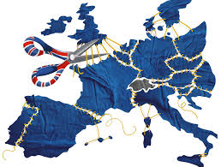

Investor’s guide and business development
India-Portugal relations
Portugal as doorway to Europe, Brazil and Africa after Brexit
  With the 2016 referendum in the UK and the Brexit decision, many foreign investors are considering other countries as alternatives.
  According to the President of the Confederation of Indian Industry, Dr. Naushad Forbes, many Indians invest in the UK with the goal of accessing the EU market. Following the uncertain turmoil around Brexit, Portugal may be seen as an attractive option. The main considerations for this are that Portugal presents:
  an inviting environment for foreign investors,
  advantageous geographic location,
  the oldest alliance in the world with the UK,
  a significant presence in strategic markets.
  As stated before, Portugal has close historical, cultural and economic relations with Brazil and some emerging African markets, such as Angola and Mozambique. Aside from sharing the same language, a large majority of Portuguese companies have some sort of activity in these markets.
  Horasis India Meeting in Portugal
  The eighth Horasis India Meeting (annual meeting, focused on economic matters in India) took place in Cascais, near Lisbon, in July 2016, attracting more than 300 delegates. Hosted by the Confederation of Indian Industries (‘CII’) and the Portuguese Government, the Horasis India Meeting offers business and government parties a platform to discuss issues related to the Indian economy while gathering decision makers from across the globe.
  Present at this event were personalities and important companies from both countries such as Bajaj Auto, EDP, Religare Enterprises, Apollo Hospitals Enterprise, Nicco Group, Bharti Enterprises, Haitong Bank Portugal and Hero MotoCorp, among several others. Alongside private sector representatives, ministers from both sides took part in the Horasis India Meeting.
  Overall, the main conclusions were:
  India’s remarkable growth is still ‘fueled’ by external sources;
  Inclusive growth and how there are still challenges to be addressed;
  Increase the promotion of good things happening in India;
  India requires better governance
  Regarding the relationship between India and Portugal, although being some way from its full potential, as stated by Mr. V.K. Singh, the Minister of external affairs and overseas India affairs, there is a cultural and historical link as well as shared values. There are plans to transform these ties into specific initiatives, and examples were given of Portuguese companies already investing in India, in several sectors, mostly in partnership with Indian companies.
Source: Visão
  There are currently several Portuguese companies investing in India, such as:
  Brisa through Ezeeway (infrastructures concession);
  Efacec (energy sector);
  Visabeira’s Vista Alegre (high quality porcelain stores);
  Sonae SR’s Sportzone in partnership with Tata group (Sport stores chain);
  Vivafit (gyms franchise).
Source: Horasis.org

Slide 66
Investor’s guide and business development
Opportunities and threats in Portugal
Opportunities
  Economic recovery - main growth driver will be represented by exports:
  • Unemployment in 2015 was at 12.4% (from 16.2% in 2013); GDP growth is forecasted to remain at 1.5% in 2018 (1.5% in 2015)
  • Exports growth was of 5.1% in 2015 and is estimated to reach 6.4% in 2017
  Correction of structural imbalances
  • Portugal already has an external balance surplus (2.5% of GDP in 2015) and has been reducing the fiscal deficit (-2.8% of GDP in 2015)
  • Public expenditure has been declining (from €93bn in 2010 to €85bn in 2014) and the structural fiscal balance improving (reaching -0.9% of GDP in 2015)
  Competitiveness
  • Around 500 measures implemented since 2011 to improve competitiveness, in a wide range of areas including ax policy, labor market, justice.
  • Cost structures very competitive and a highly qualified work force.
  Regulation
  • Portugal was in the top 10 of least restrictive countries, according to OECD (2013)
  Openness to foreign investors
  • Privatizations of some major players leading to transaction of EDP (energy), REN (energy transmission), ANA (airport concession) or EGF (waste management)
  Support offered to start-ups will boost innovation in a few years
  • Web Summit, the biggest global event in the area of entrepreneurship and technology, hosted in Portugal 2016 (2017 and 2018).
  • €200m governmental fund to support start-ups
  • increased number of hubs, accelerators and co-working spaces
Opportunities (cont’d)
  Permission “Golden Visa”
  • Foreign investors can benefit from this incentive
  Investment and fiscal facilities
  • Offered for investments which comply with certain conditions
  No local capital requirement
  • In Portugal there are no restrictions on the entry of foreign capital.
  Ease of opening a business in Portugal
  • ‘Empresa na hora’ a mechanism that will make it possible to create a company in just one office in a single day. See check link: http://www.empresanahora.pt/ENH/sections/EN_homepage for further information.
Threats
  Decrease in population
  • According to the Euromonitor, by 2030 ,the Portuguese population will fall to 9.6 million
  Small size of domestic market
  • Portuguese domestic market is not as significant as other European markets
  Modest growth of Portuguese economy
  • Despite showing positive growing signs after the 2008 financial crisis, Portugal’s growth is still low
  Political instability
  • Portugal’s change in 2015 from a centre-right government to a left wing coalition, has put at stake some policies in some key areas, namely public investment
  High public indebtedness
  • Portugal’s public debt represented in 2015 128.7% of the GDP
  Bureaucracy
  • Although measures are being taken to increase the ease of establishing a company or obtaining financial incentives, bureaucracy is still high after obtaining such facilities

Slide 67

Testimonials
Zomato
Miguel Ribeiro, Head of Growth Europe
Zomato
What was your experience since you started doing business in Portugal? What were the main benefits? What were the main challenges?
“The easiness to create a company and hiring very good people for reasonable salaries, was one of the biggest positive surprises. It is actually fairly easy to find people that speak 2-3 languages and, for a company like Zomato, this is crucial.
Also, the fact that it is easy and fast to fly anywhere in EU at low prices made Portugal the right choice, even though we still do not have direct flights from India (Delhi, Mumbai or Goa) to Lisbon. Having a direct flight from Delhi to Lisbon would make a huge difference, making it easy for investors to come to Lisbon and explore possibilities, or even come more often to visit their investments (this has been a barrier to our founders that could come to Lisbon more often. They would also consider creating a Tech Hub in Lisbon if travelling here was faster)
The challenge we've faced (and I must say not as much in Portugal as in other EU countries, specially northern European Countries) is the cultural differences - as an Indian company operating in EU we needed to adapt locally.”
What advice would you give to Indian investors which are considering investing in Portugal?
“I would advise the Indian Investors to first come and visit Portugal and our capital Lisbon, as I am sure most of them would feel very welcomed and see the real potential of this country. Not only they will be surprised by the weather, but also by the geographic privileged location and warm and intelligent work savvy people.
Many great professionals looked for opportunities abroad as, until recently, there were not many great options in Portugal. So, if these were given a chance in their own country, I am sure they will thrive and do their best work. Also I believe that Portugal is going through a very good moment, specially in Tech businesses and entrepreneurship, so this would be the right time for any investor to come in.
I also believe that there are many company CEOs and entrepreneurs like myself that would be completely available to help anyone who wants to invest in Portugal, introduce them to the right people and lead them in the right way. The startup environment in Portugal is thriving and most people involved are eager to help, connect and network.”
What sectors do you consider as being the most attractive currently in Portugal and why?
“I am obviously biased on this answer, but I see that the tech industry is having a high and enthusiastic moment. I believe our country is going through a Digital Transformation, so these are very exciting times for me, as I am very passionate about Digital Business and Digital Marketing. I feel honored to be part of this "digital transformation movement" and proud to show other countries' investors that we might be a small country, but we have many super talented people and drive to create something bigger than us. I read a few days back that Portugal once created ships to explore and discover the world, today we create leaders, entrepreneurs, and startups to do the same. Very proud times.”

Slide 68
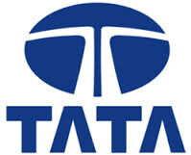
Testimonials
TATA Consultancy Services
Ana Almeida, Portugal’s Country Manager
Tata Consultancy Services
What was your experience since you started doing business in Portugal? What were the main benefits? What were the main challenges?
“In 2005, there were no Indian companies operating in Portugal and the market was interested in Indian IT companies and the worldwide experiences that these companies could bring. It was easy to have meetings and present our company to the market, especially because, TCS is an important and reputable company. This was also a key factor for the business, credibility and success.
So maybe I can resume the main benefits for us: 1) have a presence in Portugal; 2) be part of a well-known big group; 3) bringing the relevant people to Portugal when needed, to speak with the market and to provide confidence and experience; 4) bringing difference, bringing value, and finally taking Portugal to India by taking the decision makers to India to see for themselves the company and the culture.
The challenges: 1) being a new company in a very competitive landscape with so many players established for a long time; 2) showing that we are not an Indian company, but a global one instead, that we are not offshore but we are onsite, showing that we have a local presence by employing local people; 3) Portugal’s economy”.
What advice would you give to Indian investors which are considering investing in Portugal?
“Be present. Select a good local partner, a good representation and choose local people for your team”.
What sectors do you consider as being the most attractive currently in Portugal and why?
“Services and Tourism (top level) ”.

Slide 69
Investor’s guide and business development
Financial incentives schemes
Innovation financial Incentive - "SI Inovação" - Capital expenditure and HR training expenditures
  Investment projects in productive innovation which comprise the production of new goods and services or the implementation of new technological, organizational or market innovation processes.
Covered activities
Assessment basis
Forms of funding
  Acquisition of machinery and equipment directly related to the development of the project or intangible assets;
  Estimated salary cost resulting from the net creation of highly qualified jobs, as a result of the initial investment.
  Refundable cash grant that can be converted to a non-refundable cash grant up to maximum of 50%, depending on the good implementation and success of the project. Expenses related to training can always benefit from a 50% non-refundable incentive.
Incentive
Eligible to companies from all areas
  35% on top of eligible expense
Research & Development Financial Incentive – "SI I&DT"
  Investment projects in research and development activities of new products or services or new processes or production methods (per call).
  This incentive system aims to, among other things, promote the development of R&TD projects at companies and to strengthen relationships between companies and knowledge centers, accelerating the transfer and use by companies of R&TD technologies, knowledge and results.
Covered activities
Assessment basis
Forms of funding
  Personnel costs, material, subcontracting other research institutes, acquisition of patents for project purposes, equipment and software for project purposes.
  Hybrid cash grant per project and per call:
  1) Non-refundable cash grant for grant amounts up to €1m;
  2) For cash grants over €1m, a non-refundable cash grant up to Euro €1m and for 75% of the difference between the total amount of the cash grant and €1m and a refundable cash grant for 25% of the difference between the total amount of the cash grant and €1m.
Incentive
  25 % of total eligible expenses;
  Incremental rate (cumulative):
  1) 25 pp for industrial research activities (definition on the next slide);
  2) 15 pp when verified one of the following situations:
  2.1) collaboration (coordination) with undertakings;
  2.2) collaboration (coordination) with research organizations;
  2.3) wide dissemination of research results.
This incentive system supports individual and consortia projects

Slide 70
Investor’s guide and business development
Financial incentives schemes
Investment in agricultural exploration and processing and marketing of agricultural products – PDR2020
  Agriculture activities (action 3.2), which include the production, rearing or growing of agricultural products and keeping animals for production purposes or processing and marketing of agricultural products (action 3.3), i.e. the transformation and commercialization of agricultural products.
Covered activities
Assessment basis
Forms of funding
  Improvement of the land, construction of support buildings, acquisition and lease-purchase of new machines and equipment and overhead expenses (up to 5% of the remaining eligible costs).
  Action 3.2: non-refundable grant to the limit of €2m, and refundable grant for the amount that exceeds the non refundable incentive to a maximum of €2m.
  Action 3.3: non-refundable grant to the limit of €3m and refundable grant in the amount that exceeds the non-refundable incentive.
Incentive
  Action 3.2: 30% base rate over eligible expenses;
  Action 3.3: 35% base rate in less developed territories and 25% in other territories;
  Incremental rates may apply in both cases, if certain conditions are met. Action 3.2 final rates should not exceed 50% and action 3.3 rates should not exceed 65%.
Wine producers, or companies with activity in agriculture/agro-foods or tourism and hospitality are potential beneficiaries
Promotion of production and distribution of energy from renewable sources – PO SEUR
  Energy production from renewable sources (such as solar) to develop and test new technologies, as well as their integration in the grid and with tested technologies that are not sufficiently disseminated in the Portuguese territory and their integration in the grid. Energy storage, including energy from renewable sources;
Covered activities
Assessment basis
Forms of funding
  In order to determine the eligible expenses, the promoter should consider the maximum standard costs per technology.
  Non-refundable grant. However, the incentive may not exceed the necessary amount to ensure the economic viability of investments. In projects that include integration in the distribution and/or energy storage grid, the entities should not benefit from the public electricity grid remuneration scheme in the financed amount.
Incentive
  85% of eligible expenses related with studies and 65% of remaining eligible expenses (e.g.: equipment, studies, construction)
Companies should be considered ‘Special Regime Producers’, i.e., producers licensed to sell energy to the public grid.

Slide 71
Investor’s guide and business development
Tax incentives schemes
Contractual Tax Benefit (BFC)
  This tax incentive is oriented towards companies investing at least €3m in tangible and intangible assets. Investment projects must be relevant to the development of the industries considered of strategic interest to the national economy, to the reduction of regional disparities, and contributing to boost technological innovation and national scientific research.
Covered activities
Assessment basis
Forms of funding
  Investment in tangible fixed assets acquired new, exception of Land; construction, acquisition, repair and expansion of any buildings; light passenger or mixed vehicles; furniture and comfort items or decoration, social equipment; other capital goods not directly and indiscernibly associated with the company’s production;
  Tax credit with a maximum annual deduction of the greater value between 25% of the total tax credit or 50% of the tax amount in each fiscal year, unless a different limit be established contractually.
Incentive
  10% up to 25% of eligible investment; Exemption or reduction of municipality tax; Exemption or reduction of property acquisition tax; Exemption of stamp tax duty.
The investment cannot start before the submission of the application form
Investment Tax Credit – RFAI
  This tax incentive is oriented towards companies investing in tangible assets and intangible assets.
Covered activities
Assessment basis
Forms of funding
  Investment in tangible fixed assets acquired new, exception of Land; construction, acquisition, repair and expansion of any buildings; light passenger or mixed vehicles; Furniture and comfort items or decoration, Social equipment; Other capital goods not directly and indiscernibly associated with the company’s production;
  Tax credit up to 50% of the income tax liability. If tax credits granted are not deductible by insufficient tax payable in the period that were granted may be deferred up to the 10th immediate tax year.
Incentive
  25% of the eligible CAPEX up to €5; 10% of the eligible CAPEX over €5m; Exemption of municipality tax; Exemption of property acquisition tax; Exemption of stamp tax duty.
The attainment of this incentive does not require the formalization of an application, and, as such, the calculation of this benefit must be done on an annual basis and included in the CIT Tax Return

Slide 72
Investor’s guide and business development
Tax incentives schemes
R&D Tax Incentive – SIFIDE II
  This tax incentive is oriented towards companies investing in R&D.
  The following R&D-related expenses can be eligible: 1) Research expenses: acquisition of new scientific or technical knowledge;
  2) Development expenses: exploitation of research results.
Covered activities
Assessment basis
Forms of funding
  Personnel costs (PhD costs are incremented in 20%), operating expenditures (up to 55% of the personnel costs), subcontracting of other research institutes, costs regarding registry and maintenance of patents, fixed assets acquired for project purposes.
  Tax credit. If tax credits granted are not deductible by insufficient tax payable in the period that was granted, it may be deferred up to the 8th immediate tax year.
Incentive
  Base rate of 32.5% of expenses incurred in that period plus an Incremental rate of 50% of the increase in expenses incurred during that period compared to the average from the previous two fiscal years, up to €1.5m.
This incentive system supports Human Resources expenditures.
Applicants are only eligible after the project has started. Applications are submitted on an annual basis

Slide 73
Appendix
Abbreviations
€ | Euro
€…k | Thousands of Euros
€…m | Millions of Euros
€…bn | Billion of Euros
$ | US dollar
AdP | Águas de Portugal, SGPS
AICEP | Portugal global trade and investment agency
bcm | Billion cubic meters
CAGR | Compounded annual Growth Rate
CAPEX | Capital expenditure
CGD | Caixa Geral de Depósitos (Portuguese bank)
CIT | Corporate Income Tax
DGEG | General Directorate for Energy and Geology
DRDO | Defense Research and Development Organization
DTIB | Defense Technological and Industrial Base
EDA | European Defense Agency
ENMC | National Authority for Fuel Market
ERSE | Energy Services Regulatory Authority
EU | European Union
EY GIM | EY Global Investment Monitor
FDI | Foreign Direct Investment
GDP | Gross Domestic Product
GPEARI | Office for Strategy, Planning, Evaluation and International Relations
GVA | Gross Value Added
GWh | Gigawatt/hour
HICP | Harmonised Index of Consumer Prices
IMF | International Monetary Fund
INE | National Statistics Insitute
JIP-UMS | Joint Investment Program - Unmanned Maritime Systems
kb/d | Thousand barrels per day
LNG | Liquidified Natural Gas
MSW | Municipal Solid Waste
PDR2020 | Rural Development Program
n.d. | Not disclosed
PERSU | Strategic Plan for Urban Waste
R&D | Research and development
RFAI | Tax Scheme for Investment Support
SABUVIS | Swarm of Biometric Underwater Vehicles for Underwater ISR
SAMBAS | Submarine Application for the managing of Battery System
SIFIDE | Tax Incentives for Research and Industrial Development
SME | Small and medium enterprises
sq km | Square kilometer
SWM | Solid Waste Management
T&T | Travel and tourism
UAV | Unmanned aerial vehicles

Slide 74
Relevant contacts
At national level:
By sector:
  Portuguese Investment Promotion Agency (AICEP – “Agência para o Investimento e Comércio Externo de Portugal”)
  Website: www.portugalglobal.pt
  E-mail: aicep@portugalglobal.pt
  Telephone no: +351 217 909 500
Energy
  Portuguese Energy Services Regulator (ERSE – “Entidade Reguladora dos Serviços Energéticos”)
  Website: www.erse.pt
  E-mail: erse@erse.pt
  Telephone no: +351 213 033 200
  Portugal’s Competitiveness Agency (IAPMEI – “Agência para a Competitividade e Inovação”)
  Website: www.iapmei.pt
  E-mail: info@iapmei.pt
  Telephone no: +351 213 836 000
  Renewable Energy Association (APREN – “Associação das Energias Renováveis”)
  Website: www.apren.pt
  E-mail: apren@apren.pt
  Telephone no: +351 213 151 621
  Central Bank of Portugal (“Banco de Portugal”)
  Website: www.bportugal.pt
  E-mail: info@bportugal.pt
  Telephone no: +351 213 130 000
  National Entity for the Fuel Markets (ENMC – “Entidade Nacional para o Mercado de Combustíveis”)
  Website: www.enmc.pt
  E-mail: n.d.
  Telephone no: +351 213 114 140
  General Directorate for Economic Activity (DGAE – “Direção-Geral das Actividades Económicas”)
  Website: www.dgae.min-economia.pt
  E-mail: dgae@dgae.min-economia.pt
  Telephone no: +351 217 919 273
  General Directorate of Energy and Geology (DGEG – “Direção-Geral de Energia e Geologia”)
  Website: www.dgeg.pt
  E-mail: energia@dgeg.pt
  Telephone no: +351 217 922 700
  Portuguese Competition Authority (“Autoridade da Concorrência”)
  Website: www.concorrencia.pt
  E-mail: adc@concorrencia.pt
  Telephone no: +351 217 902 000
Agriculture and Agro-foods
  Portuguese Tax Authority (“Autoridade Tributária”)
  Website: www.portaldasfinancas.gov.pt
  E-mail: n.d.
  Telephone no: +351 218 812 600
  General Directorate of Agriculture and Rural Development (DGADR – “Direção-Geral de Agricultura e Desenvolvimento Rural”)
  Website: www.dgadr.mamaot.pt
  E-mail: daea@dgadr.pt
  Telephone no: +351 218 442 200
  Chamber of Commerce (CCIP – “Câmara de Comércio e Indústria Portuguesa”)
  Website: www.ccip.pt
  E-mail: geral@ccip.pt
  Telephone no: +351 213 224 050
Defense
  Portuguese Platform for Defense Industries (IdD – “Plataforma das Indústria de Defesa Nacionais”)
  Website: www.iddportugal.pt
  E-mail: geral@iddportugal.pt
  Telephone no: +351 215 885 020
  Portuguese Industrial Association (AIP – “Associação Industrial Portuguesa”)
  Website: www.aip.pt
  E-mail: inovação@aip.pt
  Telephone no: +351 213 601 000
  Ministry of National Defense
  Website: www.portugal.gov.pt/pt/ministerios/mdn.aspx
  E-mail: n.d.
  Telephone no: n.d.
  Portuguese Industrial Association (AEP – “Associação Empresarial de Portugal”)
  Website: www.aeportugal.pt
  E-mail: formacao@aeportugal.com
  Telephone no: +351 229 981 753

Slide 75
Relevant contacts
By sector (cont’d):
Tourism
Water and Waste management
  Turismo de Portugal
  Website: www.turismodeportugal.pt
  E-mail: info@turismodeportugal.pt
  Telephone no: +351 808 209 209
  Ministry of Environment
  Website: www.portugal.gov.pt/pt/ministerios/mamb.aspx
  E-mail: n.d.
  Telephone no: n.d.
  Portuguese Hotels Business Association (AHP – “Associação da Hotelaria de Portugal”)
  Website: www.hoteis-portugal.pt
  E-mail: geral@hoteis-portugal.pt
  Telephone no: +351 214 012 346
  Águas de Portugal - AdP
  Website: www.adp.pt
  E-mail: info@adp.pt
  Telephone no: +351 212 469 400
Infrastructure and Construction
  Renewable Energies Association (APREN – Associação de Energias Renováveis)
  Website: www.apren.pt
  E-mail: apren@apren.pt
  Telephone no: +351 213 151 621
  Portuguese Construction and Public Works Industries Association (AICCOPN – “Associação dos Industriais da Construção Civil e Obras Públicas”)
  Website: www.aiccopn.pt
  E-mail: geral@aiccopn.pt
  Telephone no: +351 223 402 200
  Portuguese Environment Agency (“Agência Portuguesa do Ambiente”)
  Website: www.apambiente.pt
  E-mail: geral@apambiente.pt
  Telephone no: +351 21 472 82 00
  Portuguese Ports Association (APP – “Portos de Portugal”)
  Website: www.portosdeportugal.pt
  E-mail: geral@portosdeportugal.pt
  Telephone no: +351 213 962 035
Other bodies
  The Portuguese Plastic Industry Association
  (APIP – “Associação Portuguesa da Indústria de Plásticos”)
  Website: www.apip.pt
  E-mail: apip.lisboa@apip.pt
  Telephone no: +351 213 150 633
  Ministry of Planning and Infrastructure
  Website: www.portugal.gov.pt/pt/ministerios/mpi.aspx
  E-mail: n.d.
  Telephone no: n.d.
  National Communications Authority (ANACOM – “Autoridade Nacional de Comunicações”)
  Website: www.anacom.pt
  E-mail: info@anacom.pt
  Telephone no: +351 800 206 665

Slide 76
This report was prepared in collaboration with EY

Slide 77
Contact details:
Embassy of India in Portugal
Amararam Gurjar
First Secretary
Telephone: + 351-213041095
Direct: +351 213 021 932
Email: Hoc.Lisbon@mea.gov.in
Website: www.eolisbon.in

